Slide 1
Disclaimer and Publication Details
PUBLISHED: August 2022
SUGGESTED CITATION: Goodman, D., Hillman, T., , Ciabotti, J., & Gelinne, D. (2022). Arterial Roads and Pedestrian Safety. Pedestrian and Bicycle Information Center.
DISCLAIMER: This material is based upon work supported by the Federal Highway Administration and the National Highway Traffic Safety Administration under Cooperative Agreement No. DTFH61- 16-H00029. Any opinions, findings, and conclusions or recommendations expressed in this publication are those of the Author(s) and do not necessarily reflect the view of the Federal Highway Administration or the National Highway Traffic Safety Administration.

Slide 2
Disclaimer and Publication Details
Since its inception in 1999, the Pedestrian and Bicycle Information Center’s mission has been to improve the quality of life in communities through the increase of safe walking and bicycling as a viable means of transportation and physical activity. The Pedestrian and Bicycle Information Center is maintained by the University of North Carolina Highway Safety Research Center with funding from the U.S. Department of Transportation Federal Highway Administration.

Slide 3
Notes to Presenter
This slide deck was prepared by the UNC Highway Safety Research Center and Toole Design Group in support of the FHWA-sponsored Pedestrian and Bicycle Information Center.
It is intended to serve as an open source resource for anyone who needs to prepare and deliver a presentation on the topic of pedestrian safety and arterial streets for non-commercial purposes.
Please inform PBIC (info@pedbikeinfo.org) when you use the deck and please share your feedback with us!

Slide 4
Arterial Roads and Pedestrian Safety
A Resource for State, Metropolitan Planning Organization,
and Local Planners and Engineers
Presenter Name
Date
Notes:
Talking Points:
Welcome to today’s presentation on arterial roads and pedestrian safety.
In this presentation, we are going to share information and resources intended to help you improve pedestrian safety on arterial roadways.
Improving pedestrian safety on arterials is challenging, but proven strategies exist and have been implemented throughout the United States. These can help to achieve better safety outcomes for all road users, including pedestrians.
Let’s dive in, we’ll start with a brief outline of the topics we’ll cover today.

Slide 5
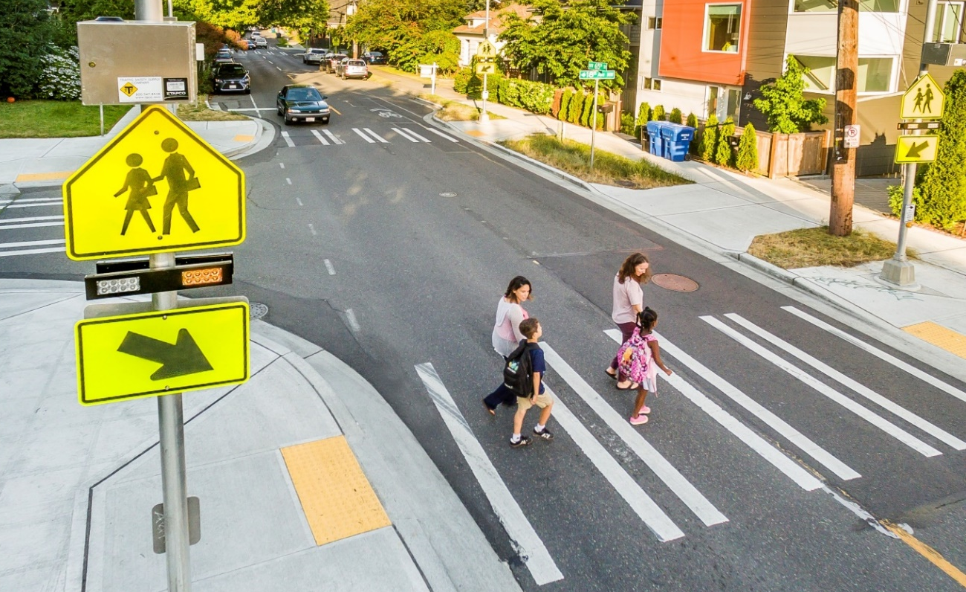
Overview of Presentation
Purpose and Context
Background
Pedestrian Safety and Arterials
Systemic Safety, Vision Zero, and Complete Streets
Safety Treatments
Resources
Conclusion
Photo source: Toole Design Group
Notes:
Talking Points:
This presentation will last approximately 45 minutes. We will have time for questions and discussion at the end. The presentation will cover the following topics:
Purpose and Context – Outlines the purpose and high-level context of the presentation, including USDOT and FHWA priorities to eliminate pedestrian deaths.
Background – A brief overview of the history and contextual background of arterial roadways in the United States, including how they have evolved, community impacts, and implications for pedestrian safety.
Pedestrian Safety and Arterials – A summary of U.S. pedestrian safety trends on arterial roadways.
Systemic Safety, Vision Zero, and Complete Streets – An overview of three organizing concepts relating to pedestrian safety and pedestrian-oriented arterial roadway design.
Safety Treatments – Information on engineering treatments intended to reduce or eliminate pedestrian deaths and serious injuries.
Resources – National resources, including design guidance and safety analysis guides, which provide more in-depth information and best practices on pedestrian safety analysis and engineering treatments to reduce or eliminate pedestrian deaths and serious injuries.
Conclusion – Summary of presentation content

Slide 6
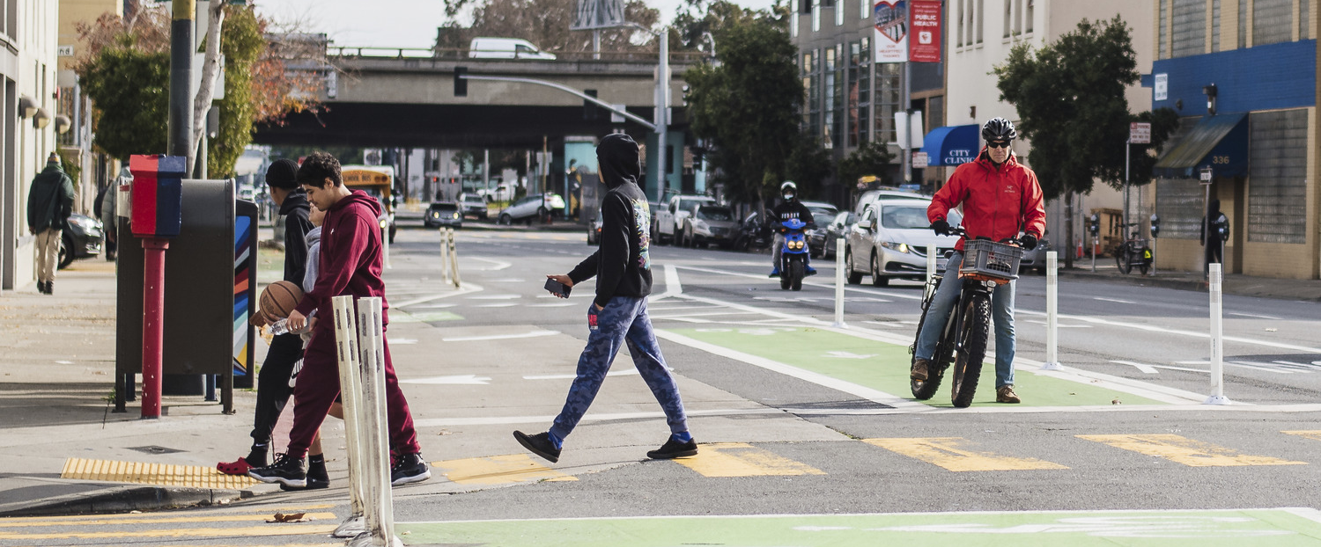
1. Purpose and Context
Photo source: Toole Design Group
Notes:
Talking Points:
First, let’s briefly review the purpose and context of today’s presentation.

Slide 7
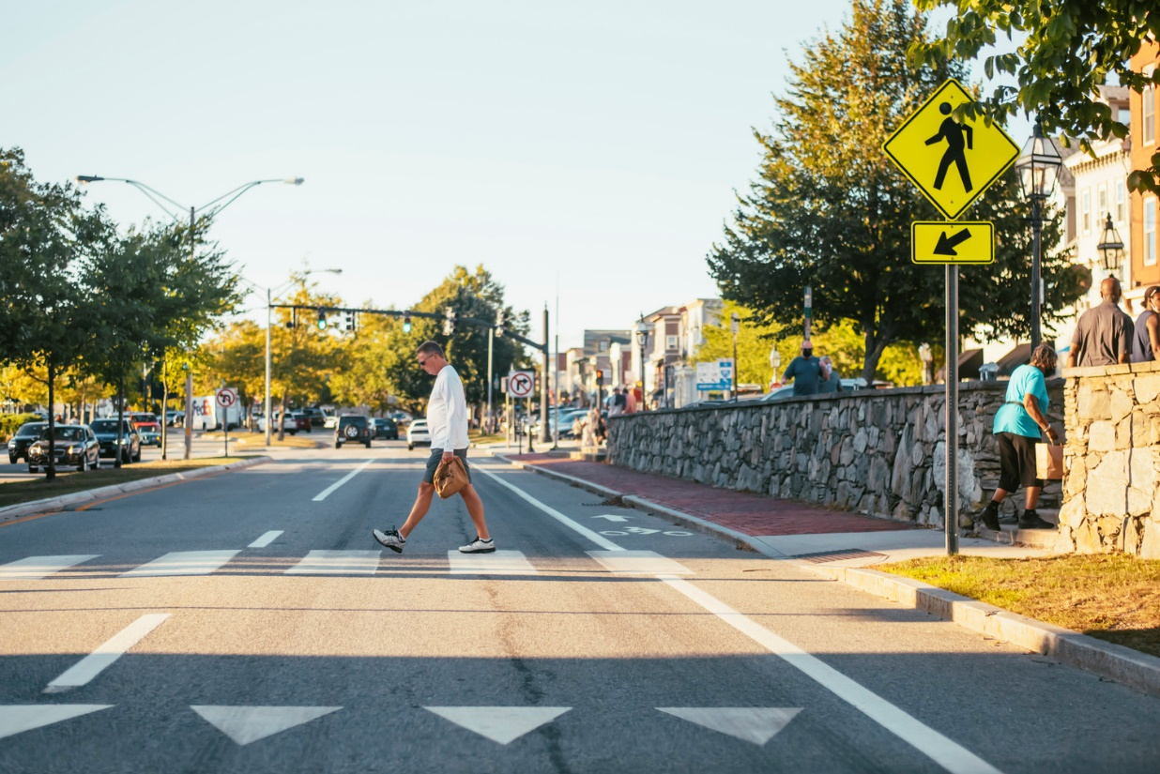
Purpose and Context
Key Takeaways
Understand characteristics, context, and history of arterial roadways
Identify specific pedestrian safety issues
Identify strategies for applying systemic safety, safe systems, and Complete Streets principles
Learn common impediments to pedestrian safety and associated countermeasures
Identify resources for more information
Photo source: Toole Design Group
Notes:
Talking Points:
The goal of this presentation is to share information about USDOT and FHWA priorities for pedestrian safety.
We will provide background about arterial roads, including their characteristics and historical context, discussing how arterial roads have been designed and built – particularly in urban areas – in the United States.
We will discuss the scale and urgency of current pedestrian safety problems on arterial roads, emphasizing safety analysis and engineering approaches designed to identify and eliminate pedestrian deaths and serious injuries.
We will outline common pedestrian safety treatment implementation challenges on arterial roads and identify strategies to overcome them and will conclude by highlighting a range of national resources practitioners can draw on to plan, design, and build arterial roads that are safer for pedestrians.

Slide 8
USDOT and FHWA Priorities
Creating a safe road system
Zero deaths
Pedestrian safety and livability
Ongoing initiatives:
USDOT Pedestrian Safety Summit 2020
USDOT Pedestrian Safety Action Plan
Notes:
Talking Points:
A livable community is one that provides safe and convenient transportation choices for everyone, whether it's by walking, bicycling, taking transit, or driving.
USDOT and FHWA have recognized the importance of delivering a transportation system that is safe for all road users and results in zero deaths.
Pedestrian safety has been prioritized nationally through a recent summit and the adoption of the USDOT Pedestrian Safety Action Plan, which includes many actions to increase pedestrian safety, for example through research and the provision of targeted resources for planners and engineers.
Sources:
FHWA’s Commitment to Zero Deaths: Saving Lives through a Safety Culture and a Safe System
https://safety.fhwa.dot.gov/zerodeaths/
USDOT Summit on Pedestrian Safety
http://www.pedestriansafetysummit.com/USDOT%20Summit%20on%20Pedestrian%20Safety%20Agenda.pdf

Slide 9
2. Background
Photo source: Toole Design Group
Notes:
Talking Points:
This section examines key issues that have contributed to systemic pedestrian safety problems that exist on arterial roads in communities throughout the U.S.

Slide 10
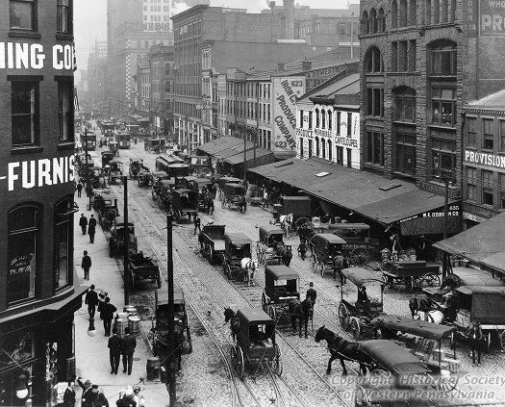
Historical Context: Changes in Land Use and Function
Photo source: Getty Open Content Program
Photo source: Toole Design Group
v
Notes:
Talking Points:
When thinking about arterial roadways, it is important to recognize historic, land use, and development context, as this helps us understand how we got to where we are today.
Many arterial roads in the United States have been developed along major commercial corridors or routes to get people and goods into and out of urban areas.
Over time, the character and context of the road, buildings, and land use has changed.
Notice how the road, buildings, and surrounding area are different in these two photographs. How did the road change? How did the buildings change?
What do you see less of in the more recent photo? (Note to speaker: the answer is people.)
What do you see more of in the more recent photo? (Note to speaker: answers could include impervious surface, lanes for motor vehicles, driveways, parking spaces and parking lots)
Sources:
None necessary for current slide content.
Alternate left image source: Unidentified American Main Street, circa 1870. https://www.getty.edu/art/collection/objects/85055/unknown-maker-american-main-street-of-an-unidentified-american-town-american-about-1870/
Left photograph: Historical Society of Western Pennsylvania
Alternate left image source2: Library of Congress, LC-D4-70158 (below) https://human.libretexts.org/Bookshelves/History/National_History/Book%3A_U.S._History_(American_YAWP)/18%3A_Life_in_Industrial_America/18.03%3A_Immigration_and_Urbanization

Slide 11
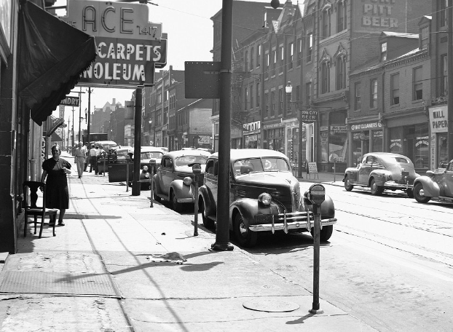
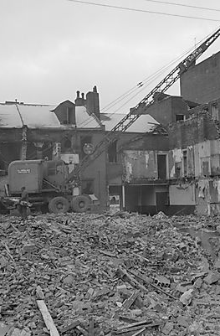
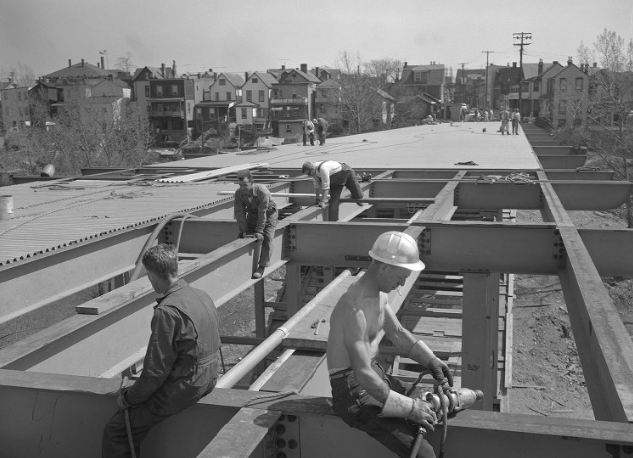
Urban Renewal Context: Part of a Larger History of Injustice
Arterial Roads connecting to suburbs, and new Civic Center, 1964
Lower Hill Neighborhood, 1952
Lower Hill Neighborhood Demolished, 1957
Photo sources: Top - Pittsburgh City Photographer Collection; bottom (L-R) - Pittsburgh Post-Gazette, Dr. Pop, Pennsylvania Aerial Imagery Navigator.
Notes:
Talking Points:
How did arterial streets change from informal dirt roads designed for the speeds of people walking or riding in horse and buggies to multi-lane, paved, and often elevated structures designed for cars driving much faster? How did those radically transformed streets appear in the heart of cities across America?
Between 1945 and the present, and particularly between 1950 and 1980, arterials were built through predominantly immigrant, Black, and low-income communities in the United States.
This negatively impacted entire neighborhoods in major US cities, including hundreds of thousands of homes and thousands of businesses. It was part of a larger history of racial injustice that included programs such as urban renewal and redlining, supported by multiple governmental and quasi-governmental institutions.
There were a lot of underlying structural reasons this happened, including suburban housing development. A core stated purpose in terms of highway construction under urban renewal was to provide fast and fluid transportation of people and goods.
Further contextual information for speaker, for background, or if needed to answer questions:
For example, the Lower Hill District in Pittsburgh, Pennsylvania, is shown on this slide before, during, and after the neighborhood was demolished in 1957. Prior to its demolition, several waves of newcomer residents including those of Jewish, Italian, Syrian, Greek, and Polish and, finally, African American descent populated the Lower Hill. Eighty city blocks, or 100 acres, were cleared, and 8,000 residents and 400 businesses were displaced to construct multiple arterial roads, including the “Cross-town Boulevard highway” (now Interstate 579) and a sports arena.
In another example, in Orange, New Jersey, the neighborhood anchored on Oakwood Avenue had over 200 homes, businesses, churches and community centers in predominantly Black and Italian neighborhoods destroyed to construct Interstate 280 and parallel arterial streets (images not shown on slide; sources below).
For a comprehensive history of federal policy and impacts of urban renewal and highway construction from 1956-1967, see the Inclusive Historian’s Handbook entry on Urban Renewal (link below).
Sources:
Left Image: Businesses on Fifth Avenue, Pittsburgh, PA – prior to Lower Hill District Demolition https://digital.library.pitt.edu/islandora/object/pitt%3A715.4162159.CP
Middle Image: Lower Hill Razing https://digital.library.pitt.edu/islandora/object/pitt%3A715.57990887.CP
Right Image: https://digital.library.pitt.edu/islandora/object/pitt%3A715.112862_4.CP/viewer
Bottom Left Image: Lower Hill District area for Redevelopment, 1950 https://digital.library.pitt.edu/islandora/object/pitt%3A715.L189.CP
Bottom Middle Image: Lower Hill District redevelopment area overlay https://drpop.org/wp-content/uploads/2009/08/hill-district-map-1.jpg
Bottom Right Image: Lower Hill District post-highway construction http://maps.psiee.psu.edu/ImageryNavigator/
Framing the Dialogue on Race and Ethnicity to Advance Health Equity: Proceedings of a Workshop https://www.nap.edu/read/23576/chapter/4
Lower Hill, Pittsburgh Redevelopment history: https://www.lowerhillredevelopment.com/site-history.html
City of Orange, New Jersey Interstate 280 construction history and impacts:
http://hiddentreasuresoforange.org/artifacts/280-an-urban-freeway
http://hiddentreasuresoforange.org/artifacts/tony-monica-i-280
The Inclusive Historian’s Handbook: Urban Renewal. 2019. https://inclusivehistorian.com/urban-renewal/#_edn3
Further reading: Mindy Thompson Fullilove, Root Shock: How Tearing Up City Neighborhoods Hurts America, and What We Can Do About It (New York: One World, 2004)
Alternate Image Sources:
Pittsburgh Post-Gazette
https://old.post-gazette.com/businessnews/20000521eastliberty1.asp
http://www.i-579captiger.com/I-579Cap01/Narrative.pdf
Archives Service Center, University of Pittsburgh https://www.pennlive.com/life/2017/04/aerial_pittsburgh_1920s_2017.html
https://aasarchitecture.com/2016/04/pittsburgh-lower-hill-master-plan-bjarke-ingels-group.html/pittsburgh-lower-hill-master-plan-by-bjarke-ingels-group-10/
Lower Hill District, with Downtown Pittsburgh in distance, circa 1906-10. Photo by William H. Matthews. University of Pittsburgh, Kingsley Association Records

Slide 12
Conventional Concept of the Role of Arterials
The hierarchy of functional systems consists of principal arterials, minor arterials, collectors, and local roads and streets
Roads making up the functional system differ for urban and rural areas
Access
Throughput
Local
Collector
Arterial
Graphic source: FHWA
Notes:
Talking Points:
We talked briefly about the historic context, now let’s discuss the role of arterials in the transportation network.
Suggest speaker ask audience “When we talk about an arterial road, what kind of street are we talking about? What are their characteristics?”
To understand what an arterial is we need to start by talking about the larger roadway network.
There are traditional definitions from AASHTO and FHWA of functional classifications, based on a road’s role in the transportation system. Arterials are traditionally seen as the highest throughput and lowest access roadway type.
There are differences between urban and suburban arterials, which we will see later in this presentation. Primary differences among them include development and land use types that occur along arterials, as well as the amount of throughput and access that occurs along them.
Let’s review this throughput vs. access role for arterials in practice on the next slide, using some real-world examples. As we do this, we’ll consider the implications for pedestrian safety.

Slide 13
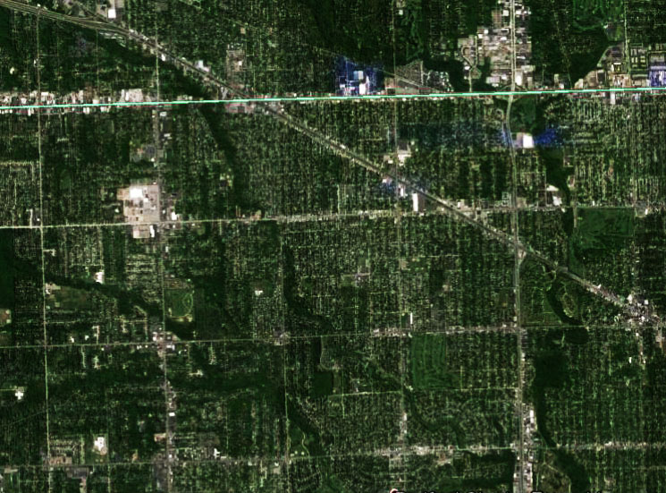
Buffalo, NY
Detroit, MI
Hartford, CT
13
February 7, 2023
Notes:
Talking Points:
Suggest to speaker that a laser pointer may be useful in pointing out major arterials on these images.
Arterial roadways shape and influence the form of our communities in cities across the US, from Buffalo, NY to Detroit, MI to Hartford, CT. Let’s consider the relationship between arterials and land use.
Can you see the arterials in these aerial photos? (They’re the wider roads)
Can you see the commercial land use? (It’s mostly clustered along the arterials, see the two north/south spines in Buffalo, grid and diagonal arterials in Detroit, and radiating arterials from downtown Hartford).
Why do you think the commercial land use is located where it is?
What are the implications for access and throughput of the commercial land use being located along these arterials?
What might the presence of commercial land use along an arterial mean for the number of pedestrians using an arterial? How about for safety outcomes?
Speaker note: Major arterials are highlighted in red; these can be shown by triggering the animation before advancing to the next slide to confirm for the audience where they all are.

Slide 14
Land Use and Pedestrian Safety
Land use planning and roadway design are often siloed from each other
Land use can complicate arterial safety
Enhanced coordination between transportation and land use decision-making can improve outcomes
Safer road systems for pedestrians include safe designs in all land use contexts
Notes:
Talking Points:
In the U.S. context, there has often been a disconnect between land use planning and roadway design.
Existing or planned land use can often complicate safer arterial design.
Greater coordination between transportation and land use decision-making can improve outcomes, as can a consideration of the safety of the whole roadway system, rather than separate mode-specific approaches.
Source:
For more information, see: https://usa.streetsblog.org/2020/10/14/worst-practices-how-urban-planning-fails-vision-zero/

Slide 15
Context Sensitive Solutions
Rural
Rural Town
Suburban
Urban
Urban
Core
Graphic adapted from FDOT Context Classification Guide
Notes:
Talking Points:
Let’s talk more about land development patterns and built form.
In rural and natural areas, fewer pedestrians may be expected, since there are few surrounding land uses that generate significant amounts of pedestrian travel and very long distances between them. However, pedestrian safety measures are still necessary in rural areas to protect vulnerable road users and reach the goal of zero deaths. This is especially true where pedestrian generators are present in rural areas, such as near trails or at trail crossings, near development, and at intersections. Arterial roads are less common in rural areas, since lower volumes of users are expected for all modes.
In the urban core, the most pedestrians may be expected, since it has the highest intensity of land use and many pedestrian origins and destinations close together. Arterial roads are common in urban areas, since traditional street designs have prioritized moving high volumes of motor vehicles through these areas to move people and goods. A broad array of pedestrian safety treatments are appropriate on arterial roads in this context.
In areas in between (especially suburban, exurban, and urbanized areas outside the urban core) varying amounts of pedestrians may be expected. These areas typically have many arterial roads due to the high volume of motor vehicles. Arterials in these areas, especially exurban and suburban areas, tend to have higher speed limits to facilitate faster travel over longer distances. Since fewer pedestrians are present in these contexts, drivers may not expect them and crashes may occur at higher speeds, causing a higher chance of serious injuries or fatalities.
As alluded to above, the existing design and function of arterials through these contexts is not the same. For example, in the urban core, posted and design speeds tend to be lower, while speed limits in suburban areas may be higher. Actual speeds may vary in each of these contexts and can contribute to serious or fatal pedestrian crashes in both cases.
Factors including the distance served (and length of route), number and design of access points, speed limits, distance between routes, motor vehicle and pedestrian usage (AADT, AADPT, DVMT, DPMT), number of travel lanes, and presence and design of pedestrian facilities all vary widely for arterials across these contexts.
We will discuss each of these roadway characteristics – and their implications for pedestrian safety – in greater detail throughout this presentation.

Slide 16
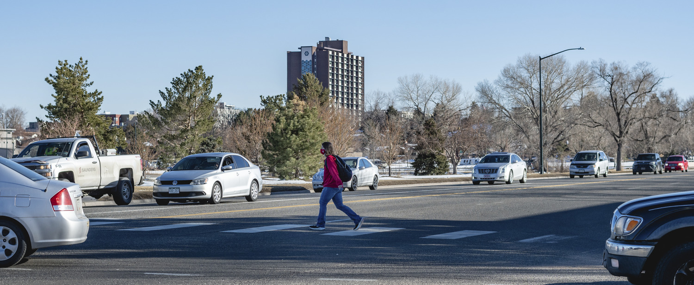
3. Pedestrian Safety and Arterial Roadways
Photo source: Toole Design Group
Notes:
Talking Points:
The next section of this presentation examines data relating to pedestrian safety and arterial roadways.

Slide 17
Pedestrian Safety is an Urgent Problem in the US
US pedestrian deaths have
increased by 53%
in the past decade
From 2009 to 2018, pedestrian fatalities increased
70 percent on principal arterials
76 percent on minor arterials
Source: National Highway Traffic Safety Administration, 2019
Notes:
Talking Points:
US pedestrian deaths have increased by 53% in the past decade.
The risk of pedestrian fatality increases as traffic increases (Galanis et al. 2017).
Principal and minor arterials are especially challenging because they carry high traffic volumes, often at high speeds.
According to the AASHTO Green Book, principal arterials “serve the major centers of activity of urban areas, the highest vehicular traffic volume corridors, and the longest trip lengths in an urban area.” Many urban principal arterials also serve high volumes of bicycle and pedestrian travel, especially those with no access control.
Minor arterials “interconnect with and augment the urban principal arterial system.”
From 2009 to 2018, the largest increase in pedestrian fatalities occurred on principal and minor arterial roads – over a 70% increase in pedestrian deaths.
This problem appears to have not only continued, but to have gotten worse in 2020. According to GHSA’s preliminary 2020 data:
For all 50 states and D.C. combined, the number of pedestrian fatalities for January-December 2020 is projected to have increased by 4.8%, or 309 additional pedestrian deaths in 2020 compared with 2019.
If this projection proves accurate, the number of pedestrian fatalities for 2020 would be the largest number of pedestrian deaths reported in FARS since 1989.
Sources:
Galanis, A., Botzoris, G., & Eliou, N. (2017). Pedestrian road safety in relation to urban road type and traffic flow. Transportation research proceeding, 24, 220–227.
National Highway Traffic Safety Administration Fatal Accident Reporting System (FARS) 2019.

Slide 18
Arterials are Disproportionately Dangerous for Pedestrians
Source: Bureau of Transportation Statistics, 2019
Source: Governor’s Highway Safety Administration, 2019
Notes:
Talking Points:
Thirteen percent (13%) of US roadway miles are non-interstate arterials (Total Lane Miles: 8,794,569. Total Non-Interstate Arterial Lane Miles: 1,128,961).
Yet in recent years more than half (59%) of US pedestrian fatalities occurred on these roads.
Sources:
Bureau of Transportation Statistics Estimated US Roadway Lane-Miles by Functional System (2018): https://www.bts.gov/content/estimated-us-roadway-lane-miles-functional-system
Governor’s Highway Safety Administration Pedestrian Fatalities by State 2019 Report (of 2018 data) https://www.ghsa.org/sites/default/files/2020-02/GHSA-Pedestrian-Spotlight-FINAL-rev2.pdf

Slide 19
Highway Functional Classifications
Functional Classification | Distance Served (and Length of Route) | Access Points | Speed Limit | Distance between Routes | Usage (AADT and DVMT) | Significance | Number of Travel Lanes
Arterial | Longest | Few | Highest | Longest | Highest | Statewide | More
Collector | Medium | Medium | Medium | Medium | Medium | Medium | Medium
Local | Shortest | Many | Lowest | Shortest | Lowest | Local | Fewer
Assumption is moving many cars quickly
Creates pedestrian safety problems, especially in areas with many destinations and jobs
Notes:
Talking Points:
This chart highlights a problematic reality from a pedestrian standpoint: Commercial development, destinations, and transit along arterials creates more potential interactions between vehicles and pedestrians; however, these roads are also designed for higher motor vehicle speeds and volumes and they typically have more travel lanes, which create longer pedestrian crossing distances.
It should be noted that changes to road design priorities to further emphasize safety for all road users—with the assumption that no death is acceptable—have resulted in a rethinking of appropriate speed limits for arterial roads in areas with higher expected pedestrian activity (for example in suburban and urban land use contexts).
For more information and resources on setting safe speed limits on urban streets, see the FHWA’s Proven Safety Countermeasures Speed Management tools at https://safety.fhwa.dot.gov/provencountermeasures/.

Slide 20
Research Shows Arterial Safety Issues for Pedestrians
In a recent study of the top 34 pedestrian fatality hot spot corridors in the US:
Almost all (97%) are multilane roadways
70% require pedestrians to cross five or more lanes
Over three quarters have speed limits of 30 mph or higher
62% have traffic volumes over 25,000 vehicles per day
Nearly all had adjacent commercial land uses
Three quarters were bordered by low-income neighborhoods
Source: Schneider, R.J., R.L. Sanders, F.R. Proulx, and H. Moayyed. “United States Fatal Pedestrian Crash Hot Spot Locations and Characteristics,” Journal of Transport and Land Use, Volume 14, Number 1, pp. 1-23. DOI: https://doi.org/10.5198/jtlu.2021.1825, 2021.
Notes:
Talking Points:
What are some of the key characteristics of arterials that can make them dangerous for pedestrians?
They have…
Multiple lanes
High motor vehicle speeds
High motor vehicle volumes
Adjacent commercial land uses, and
Adjacent low-income neighborhoods, which may increase the amount of pedestrian activity, for example people walking to access transit
There are several design solutions that can mitigate these safety concerns, including providing continuous sidewalks and appropriately marked, protected and spaced pedestrian crossings. We will learn more about these and other pedestrian safety treatments later in the presentation and provide information about multiple guidebooks and other sources of information for effective pedestrian safety planning and engineering.
Source:
Schneider, Sanders, and Proulx. 2020. United States Fatal Pedestrian Crash Hot Spot Locations and Characteristics. Transportation Research Board Annual Meeting, 2020. Manuscript Number: 20-02402

Slide 21
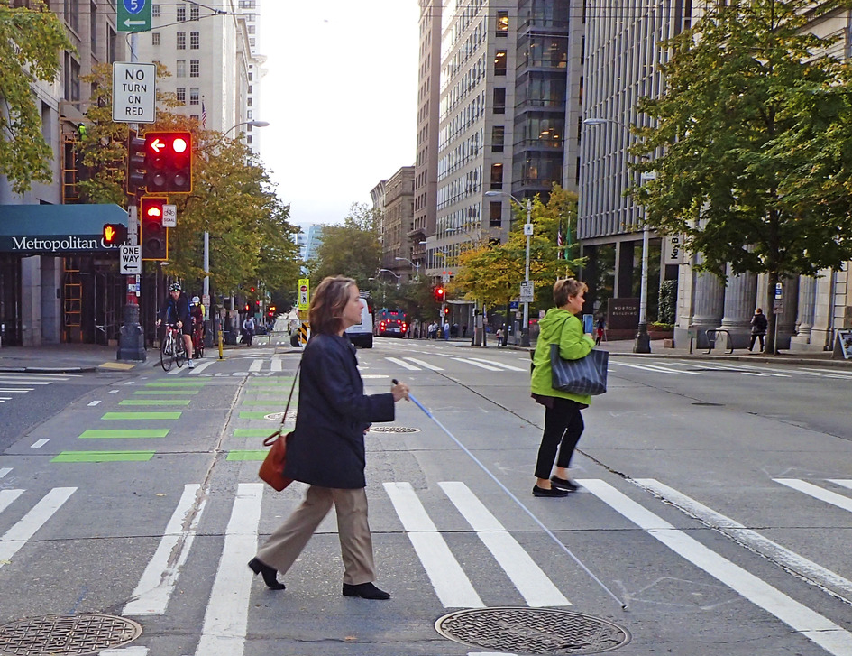
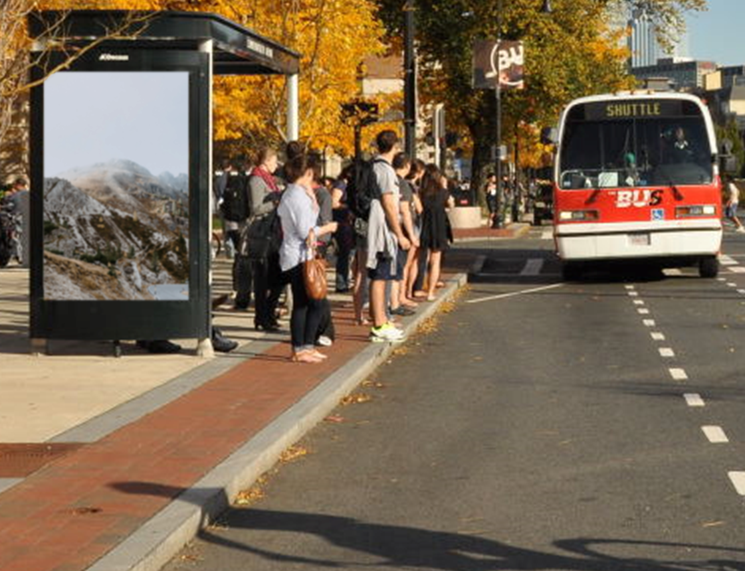
Pedestrian Experience on Arterials: Urban Context
Photos source: Toole Design Group
Notes:
Talking Points:
Consider these examples of the pedestrian experience on arterials in the urban context. What is good about them? What is challenging?
Speaker note: If needed, instruct participants to consider all aspects of the scene – crosswalks, transit access, lighting, sidewalks, buffers, etc.).

Slide 22
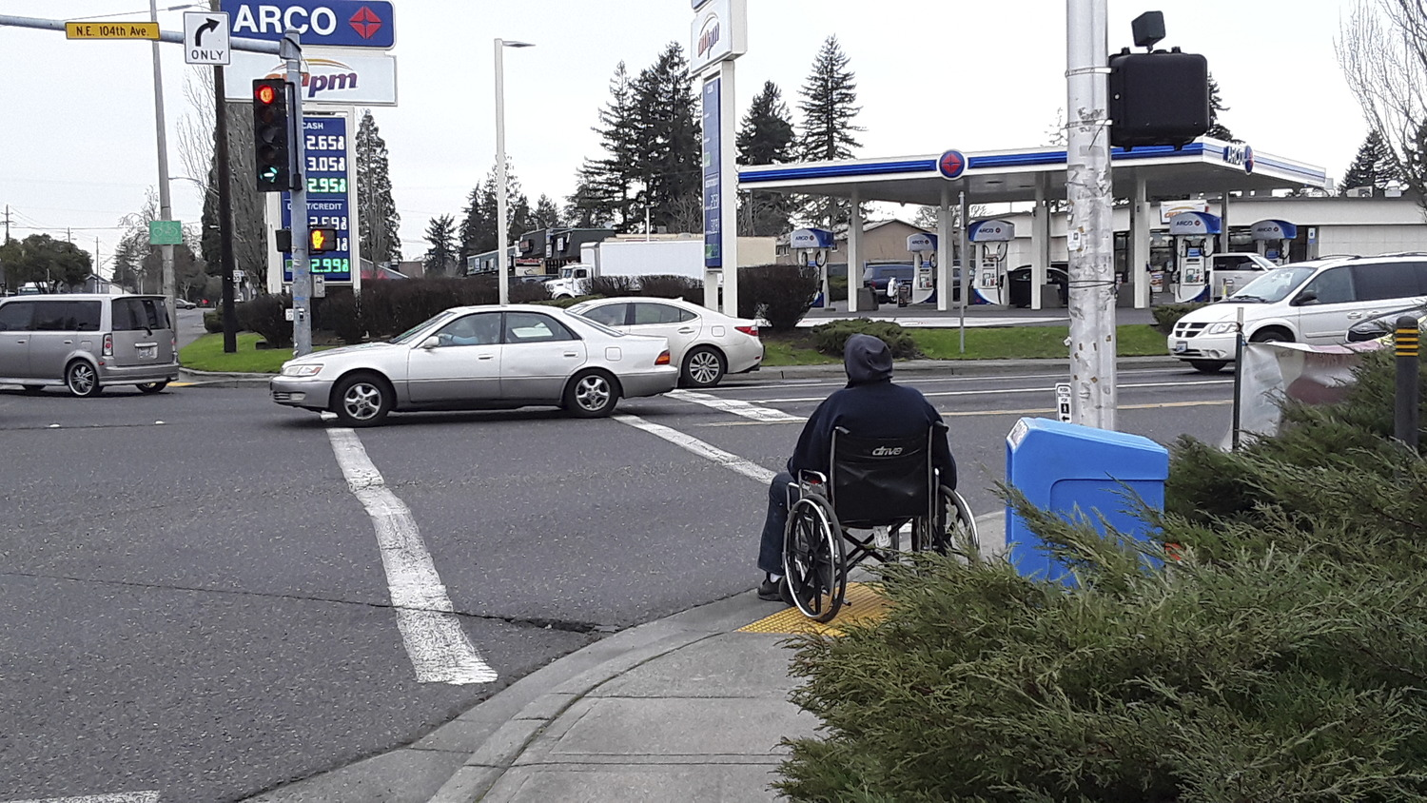
Pedestrian Experience on Arterials: Suburban Context
Photo source: Toole Design Group
Notes:
Talking Points:
How about this example of the pedestrian experience on an arterial in the suburban context. What is good about this and what is challenging?
Speaker note: If needed, instruct participants to consider all aspects of the scene, including sidewalks, curb ramps, driveways, pedestrian crossing signals, etc.).

Slide 23
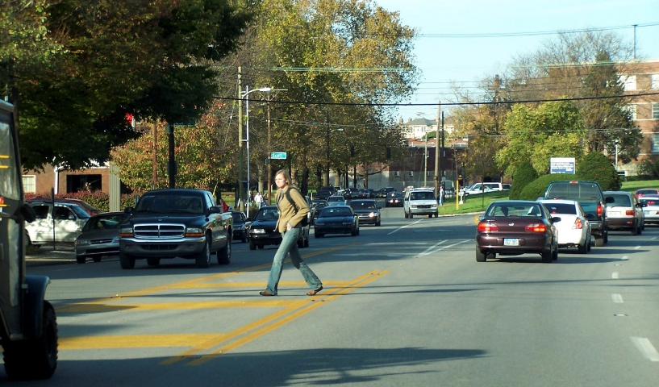
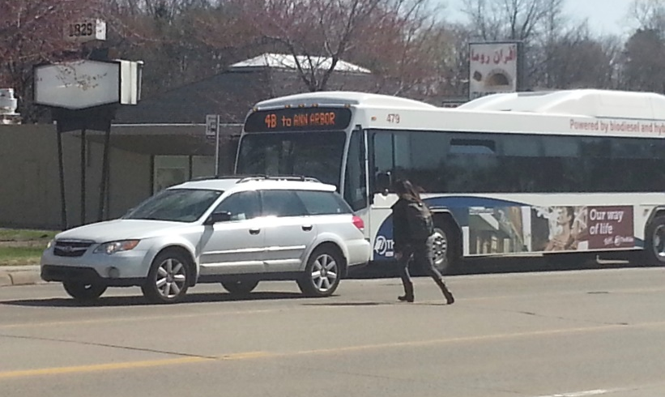
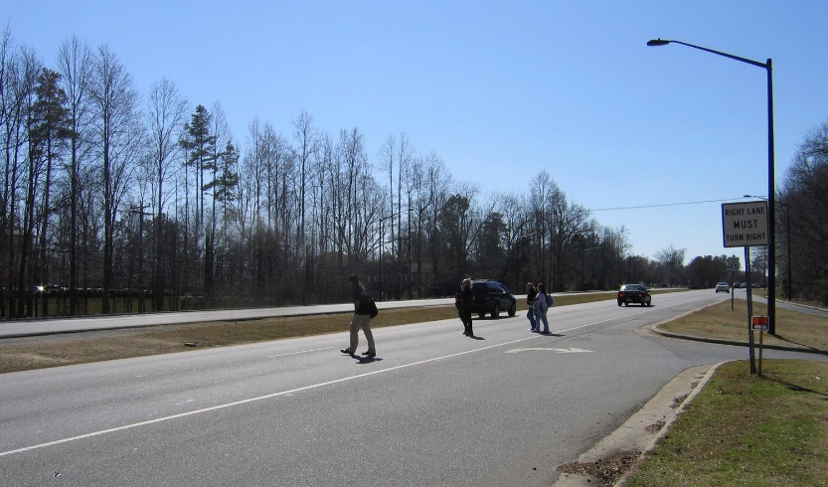
Common Unsafe Conditions on Arterials
Lack of sidewalks
Lack of pedestrian signals and marked crossings
Intersections with fewer than all crosswalks marked
Bus stops without sidewalks or marked crossings
Schools on high-speed arterials
No marked crossing opportunity
No sidewalk near bus stop
No crosswalk near bus stop
No pedestrian facilities near school
Photos source : Toole Design Group
Notes:
Talking Points:
While there are a wide variety of unsafe conditions that contribute to pedestrian injuries and fatalities, let’s review some of the ones most commonly found on arterial streets.
Speaker note: Speaker briefly reviews each bulleted item, recommend using a laser pointer for specifying locations.
What does it mean when fewer than all crosswalks are marked? E.g., 0-3 out of 4 total crossings are marked for pedestrian use. The assumption is that pedestrians should use that route only to reach their destination.
Why might that happen at an intersection?
What are some potential drawbacks of that decision to not mark all crosswalks for pedestrians? Speaker note: This can cause additional delay when pedestrians must cross out of their way to reach a destination, especially if they must wait for multiple traffic signal cycles to complete the crossing. For more information, see: https://ggwash.org/view/29920/8-minutes-to-cross-the-street.
What safety impacts might that decision have for pedestrians? Speaker note: Pedestrians may decide to cross against the signal or to cross where a marked crossing is not present to avoid undue delay and detour.

Slide 24
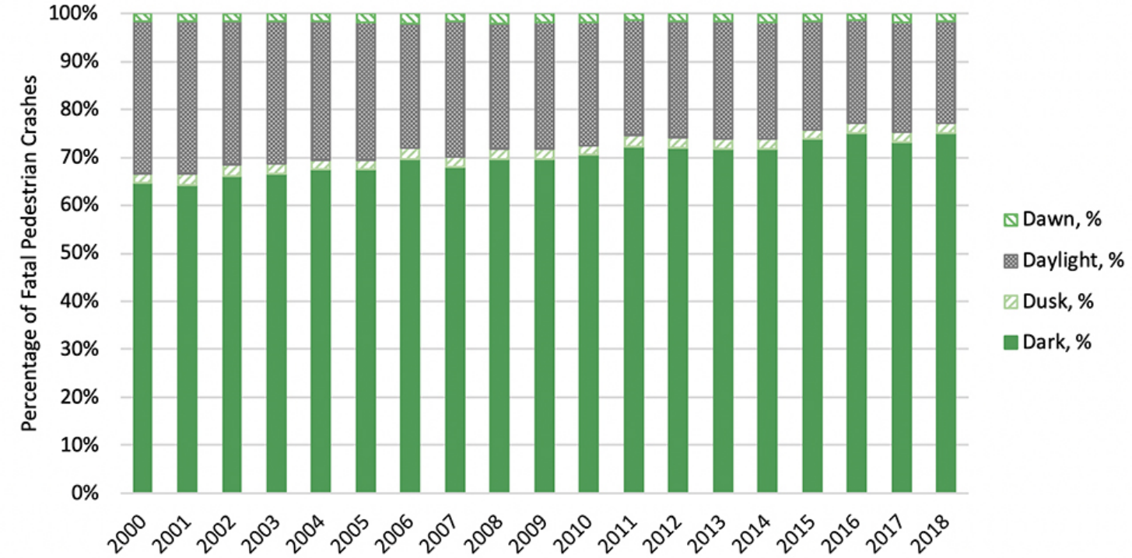
Lighting and Pedestrian Safety on Arterials
Source: PBIC Toward a Shared Understanding of Pedestrian Safety, 2020
Notes:
Talking Points:
A growing majority of fatal pedestrian crashes occur in dark conditions, underscoring the need for better lighting.
Inadequate lighting is problematic on all roadway types but is especially dangerous on arterials.
This chart shows the percentage of fatal pedestrian crashes that occur in dark settings.
Source:
PBIC Toward a Shared Understanding of Pedestrian Safety, 2020
http://pedbikeinfo.org/cms/downloads/PBIC_Pedestrian%20Safety%20Background%20Piece_7-2.pdf

Slide 25
Centering Equity
Photo source: Toole Design Group
Notes:
Talking Points:
As we discussed earlier in the presentation, it is important to understand historic inequities when considering the planning and design of arterials—and how they have contributed to disparate pedestrian safety outcomes.
A conventional arterial definition does not define mobility for whom and using what mode and it was assumed that “mobility” was primarily designed for journeys to work or goods distribution via private automobile.
As a result of this mentality, people with less access to cars have borne unfair environmental and transportation safety burdens because they were different from those in power and often intentionally discriminated against.
As we will see in an upcoming section, more recently, the concept of Complete Streets has clarified that safe mobility options should be provided for all road users – including pedestrians, bicyclists, drivers, and people using public transit.
Additional background (for reference if desired)
America’s transportation system was used throughout the 20th century as a tool to maintain racial segregation. As we saw previously, throughout much of the 20th century, arterial roadway projects often destroyed homes, commercial corridors, and neighborhoods owned or occupied by Black, recent immigrant, or lower-income people as a part of urban renewal projects. Moreover, arterial streets were encouraged to be built along the borders between predominantly white, non-immigrant, and wealthier communities and communities without those characteristics by the Federal Housing Administration’s Underwriting Manual. This practice was encouraged to maintain property values and discourage people of color from entering predominantly white neighborhoods. In this way, the role of an arterial as a barrier between parts of a community – especially as a barrier for people walking to safely reach their destination – was recognized early in the 20th century and intentionally implemented to make it inhospitable and unsafe for people to walk along or across.
Or, as the 1939 Underwriting Manual stated…
“Natural or artificially established barriers [for example, an arterial roadway] will prove effective in protecting a neighborhood … from adverse influences,”
These barriers aid in “the prevention of the infiltration of … lower class occupancy and inharmonious racial groups.”
“A high-speed traffic artery or a wide street parkway may prevent the expansion of inharmonious uses to a location on the other side of the street. However, if a high-speed traffic artery passes directly through a desirable neighborhood area with similar development on either side of the artery, the noise and attendant danger constitute an adverse influence, rather than a protection.” (Federal Housing Administration Underwriting Manual, 1939, Part II, Section 9 – Rating of Location, Paragraph 935: Natural Physical Protection. HA Form no. 2049. Emphasis added).
This legacy of racist and non-inclusive planning has contributed to inequitable pedestrian safety outcomes on arterial roadways in the United States that persist today on streets that maintain the same or very similar designs as were originally implemented in this period.
Source:
Federal Housing Administration Underwriting Manual. 1939. https://www.huduser.gov/PORTAL/publications/Federal-Housing-Administration-Underwriting-Manual.html

Slide 26
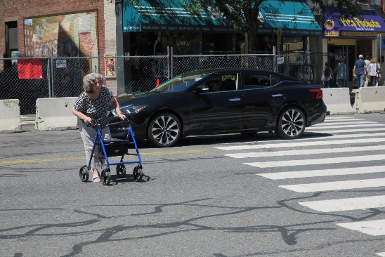
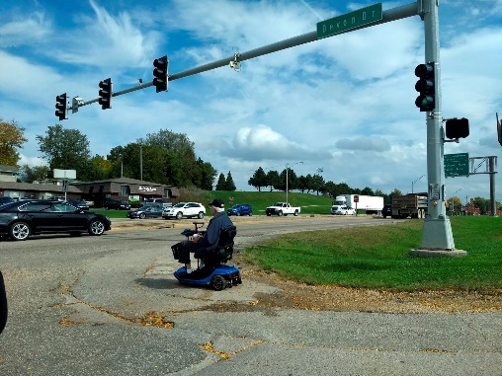
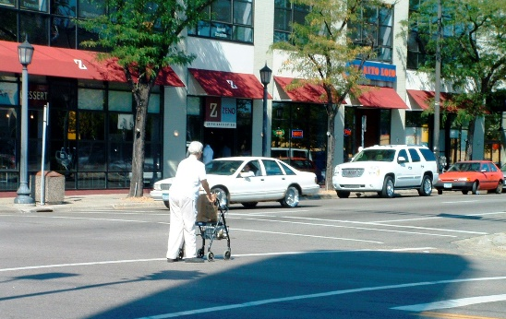
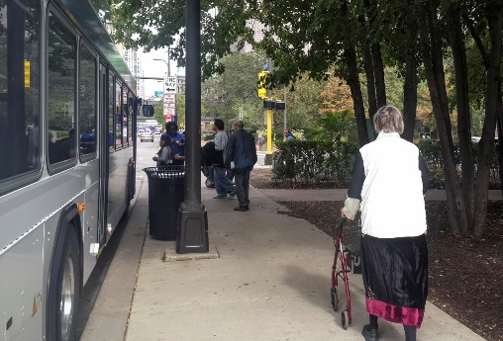
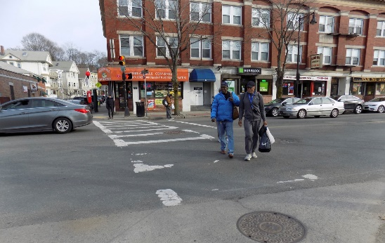
Pedestrian Safety Inequities
Greater reliance on walking and public transit:
People with lower-incomes
Older people
Youth
People with disabilities
Essential services often located on arterials lacking pedestrian safety infrastructure:
Grocery stores
Pharmacies
Daycares
Multifamily housing
Senior centers
Bus stops
Photos source: Toole Design Group
Notes:
Talking Points:
Some groups rely more on walking and wheeling for transportation than others, and many essential services are located on arterials. This creates inequities if arterials are not designed for pedestrian safety.
In addition to the inequitable planning and engineering outcomes that have contributed to existing pedestrian safety inequities, some of the same groups, and others such as youth, older people, and people with disabilities, have a greater reliance on walking. People with a greater reliance on walking may need to walk to essential services located on arterials lacking pedestrian safety infrastructure, and they may have no other choice than to walk even when pedestrian conditions are unsafe.
This is especially a concern for elderly pedestrians who often need to cross the street more slowly and are most at risk of serious or fatal injury in the event of a crash due to their bodies’ more limited capacity to recover from physical trauma.
The list of essential services that are often located on arterials is long. Speaker read 1-3 examples from list of essential services.
Suggested question for participants: “What other essential services can you think of that are often located on arterials, beyond what’s on this list?” (Note to speaker: examples include libraries, convenience stores, banks, K-12 schools, parks, post offices, laundromats, and community centers).

Slide 27
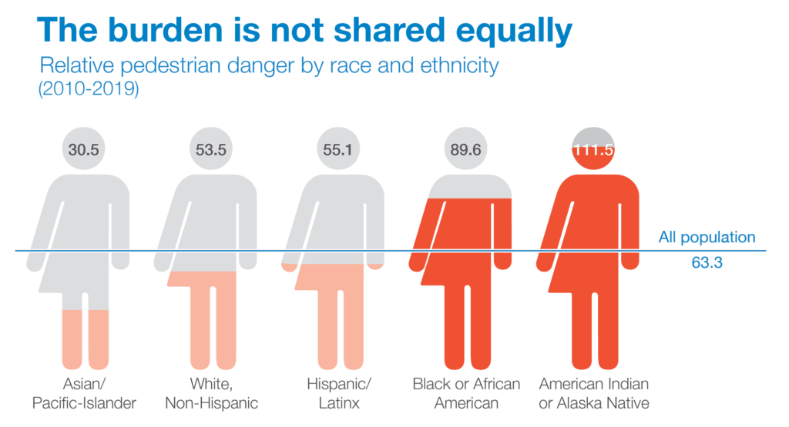
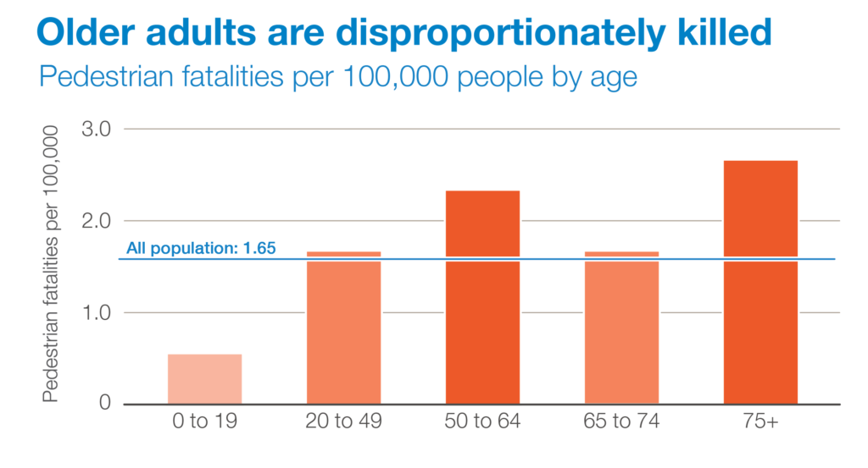
Pedestrian Safety Inequities
Pedestrian Danger Index: Fatality rate/Walk-to-work rate
(2010-2019)
Black and Indigenous people have higher pedestrian death rates, even when controlled by walking rates
Lower-income neighborhoods have higher pedestrian death rates
Older pedestrians have higher death rates
Source: National Complete Streets Coalition, Dangerous by Design 2021
Notes:
Talking Points:
These inequitable roadway and land use designs and demographic dynamics are also reflected in disparate pedestrian death rates. Black, Indigenous, older, and lower-income pedestrians are killed at higher rates on US roads than other racial, ethnic, age, and income groups, even when controlled for their higher likelihood of walking.
Transportation planners and engineers are now also increasingly acknowledging that the perspectives and knowledge of people in these groups provide necessary expertise to design safer roads that serve all road users.
The graph shows Pedestrian Danger Index, an index created for the Dangerous by Design report that normalizes pedestrian fatality rate (deaths per 100,000 people) by the walk-to-work rate from US Census ACS data.
Source:
National Complete Streets Coalition, Dangerous by Design 2021

Slide 28
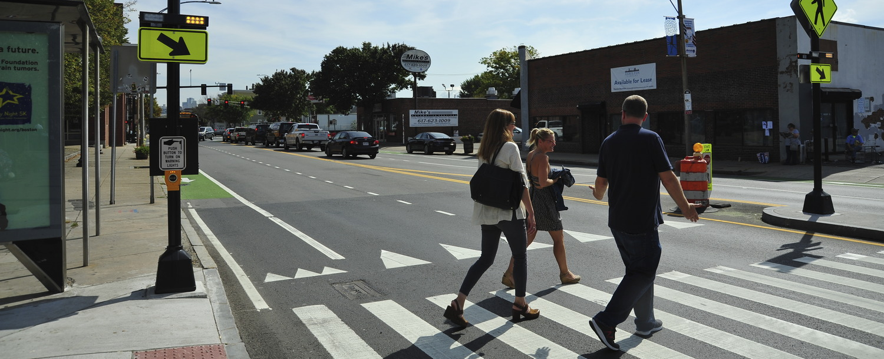
4. Systemic Safety, Vison Zero, and Complete Streets
Photo source: Toole Design Group
Notes:
Talking Points:
What do we do about this? How can we make arterial roadways safer and more comfortable for pedestrians? In this section we’ll review the current state-of-practice for planning and designing safer and more equitable arterial roads.

Slide 29
The Safe System
People make mistakes
Bodies are vulnerable
Deaths or serious injuries not acceptable
Redundant safety measures create layers of safety
Infrastructure is key
Influences user behavior
Alters crash dynamics
Graphic source: FHWA, 2020
Notes:
Talking Points:
A Safe Systems approach anticipates human error and accommodates human injury tolerance.
A crucial aspect of creating a safe system is building transportation infrastructure designed for safe target speeds and safe operation by all road users. Using a safe system approach requires actively designing roads for safe travel speeds, based on the land use context and the mix of road users, not setting speed limits based on the highest speeds people choose to travel or assuming that only minimizing car travel time should factor into the speed limit decision.
Implementing multiple layers of safety infrastructure at a given location is key to influencing user behavior, altering crash dynamics, and creating substantial improvements in safety. For example, a given intersection may have multiple pedestrian safety treatments. We will discuss specific pedestrian safety treatments and implementation strategies in greater detail in the next section.
Other aspects of a safe system approach beyond roadway engineering include encouraging and educating people to use the road system safely, providing quick and effective post-crash medical care, and engineering safe vehicles – for example, front car assemblies that are designed to minimize leg injuries or head and chest trauma if a pedestrian is struck.
Source:
FHWA Safe System Flyer: https://safety.fhwa.dot.gov/zerodeaths/docs/FHWA_SafeSystem_Brochure_V9_508_200717.pdf

Slide 30
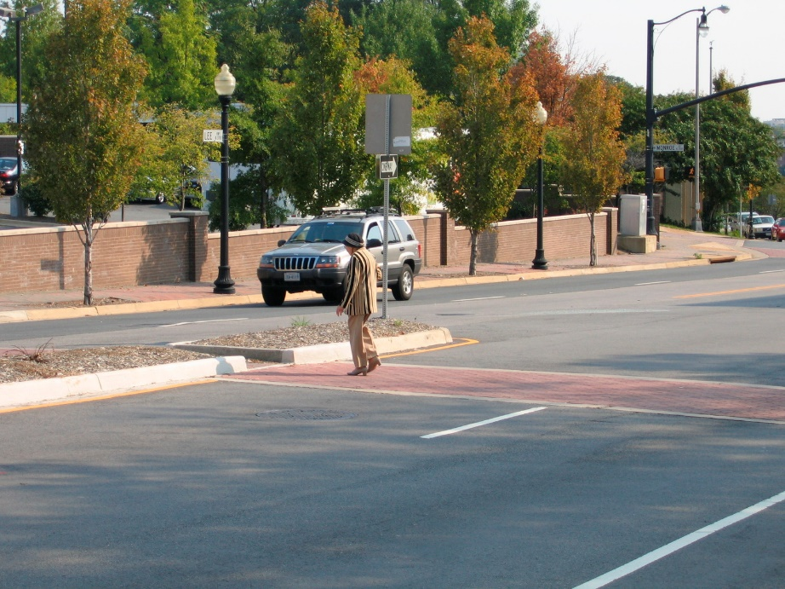
Systemic Pedestrian Safety Infrastructure
A systemic approach to pedestrian safety infrastructure implementation identifies many locations for rapid application of safety measures designed to avert severe and fatal crashes—throughout the roadway system.
According to the Federal Highway Administration
“The systemic approach to safety involves widely implemented improvements based on high-risk roadway features correlated with specific severe crash types. The approach provides a more comprehensive method for safety planning and implementation that supplements and complements traditional site analysis. The approach also helps agencies broaden their traffic safety efforts and consider risk as well as crash history when identifying where to make low-cost safety improvements.”
Photo source: Toole Design Group
Source: FHWA Systemic Safety Project Selection Tool, 2013
30
February 7, 2023
Notes:
Talking Points:
Systemic crash reduction treatments are designed to achieve the following primary pedestrian safety objectives:
Reduce exposure, for example by separating pedestrians and motorist on busy and high-speed roads
Minimize risk of a crash given a certain level of exposure, for example by reducing crossing width
Reduce severity given a crash, for example by reducing motor vehicle speeds
Source:
FHWA. Systemic Safety Project Selection Tool. https://safety.fhwa.dot.gov/systemic/fhwasa13019/chap1.cfm#chap111

Slide 31
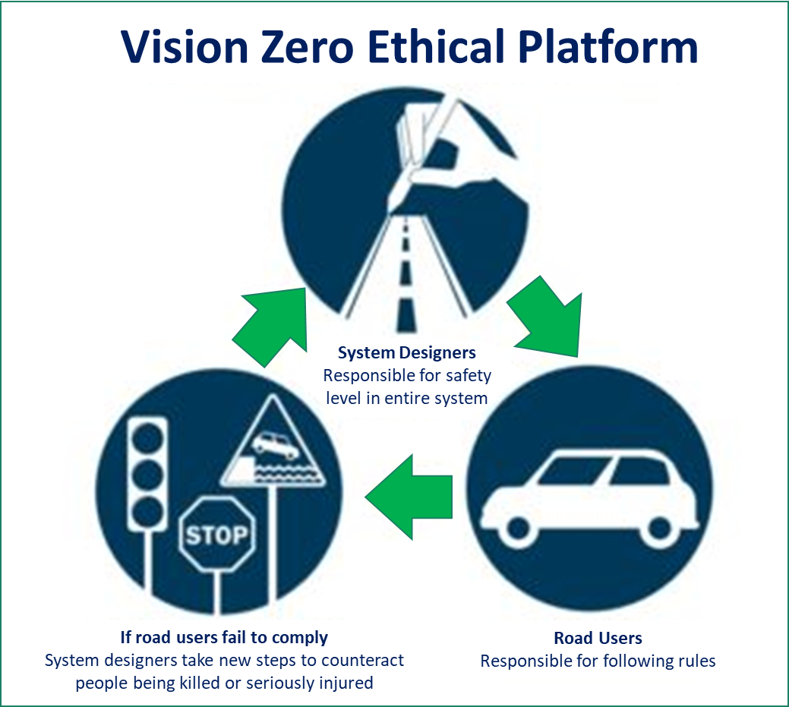
Vision Zero
Graphics source: Vision Zero Network
Notes:
Talking Points:
Vision Zero is another strategy to eliminate all traffic fatalities and severe injuries, while increasing safe, healthy, and equitable mobility for all.
Vision Zero articulates an explicit ethical platform, wherein system designers are responsible for safety in the entire road system, including pedestrian safety on arterial streets. Meanwhile road users are responsible for following the rules.
However, if road users do not comply, system designers are ethically obligated to take new engineering steps to counteract people being seriously injured or killed as a result of these mistakes.
Source:
www.visionzeronetwork.org

Slide 32
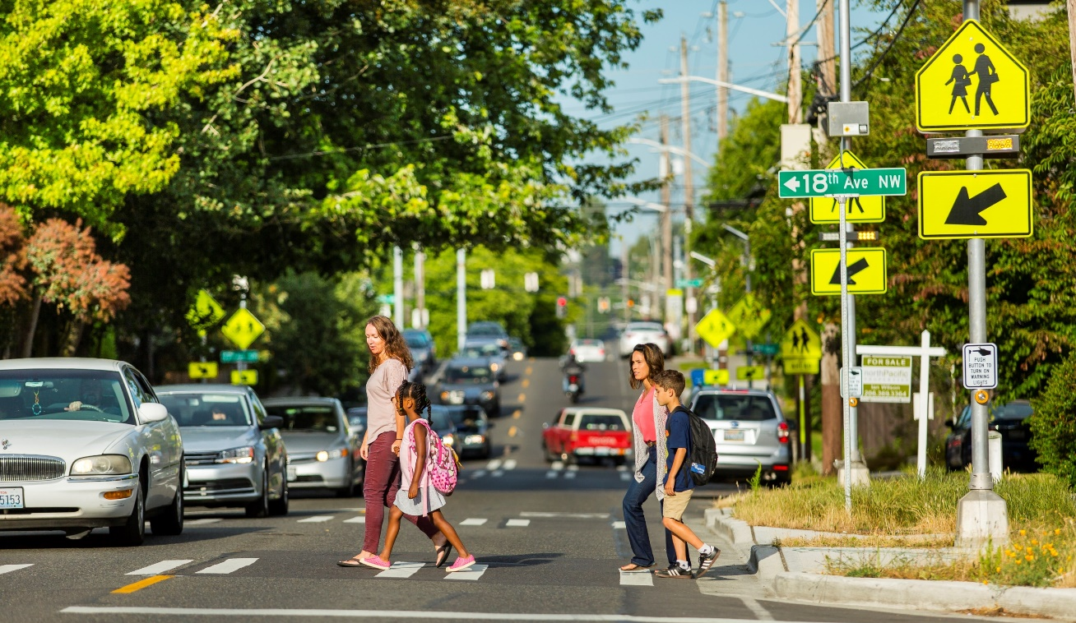
Complete Streets and Equity on Arterials
Equity Imperatives:
Streets should not pose disproportionate safety burdens
Pedestrians should be able to reach their destination safely and comfortable
Income or racial distribution should not influence how likely a person is to die while walking along or crossing a road
Photo source: Toole Design Group
Notes:
Talking Points:
With respect to pedestrian safety, Complete Streets:
Provide safe, accessible and healthy travel options for everyone
Accommodate pedestrians, bicyclists, transit riders and motorists, and
Use context-appropriate pedestrian safety treatments
From an equity imperatives perspective, this means streets should not pose disproportionate safety burdens, that pedestrians should be able to reach their destination safely and comfortably, and that income or racial distribution should not influence how likely a person is to die while walking along or crossing a road.

Slide 33
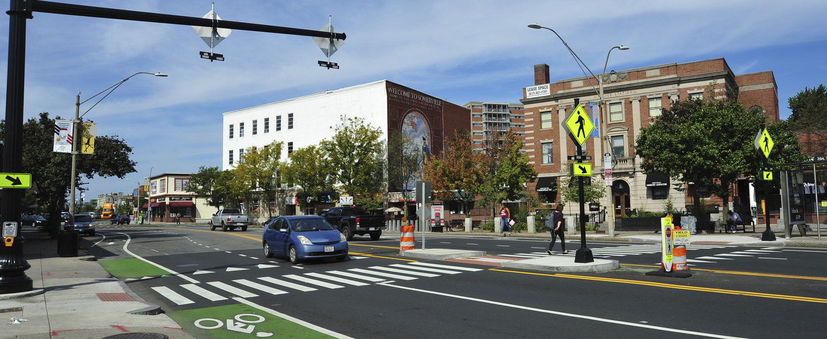
5. Safety Treatments
Photo source: Toole Design Group
Notes:
Talking Points:
Now let’s learn more about context-appropriate safety treatments. The next section reviews a variety of planning and design considerations and safety treatment applications to improve arterial functioning for all users, while enhancing pedestrian safety.

Slide 34
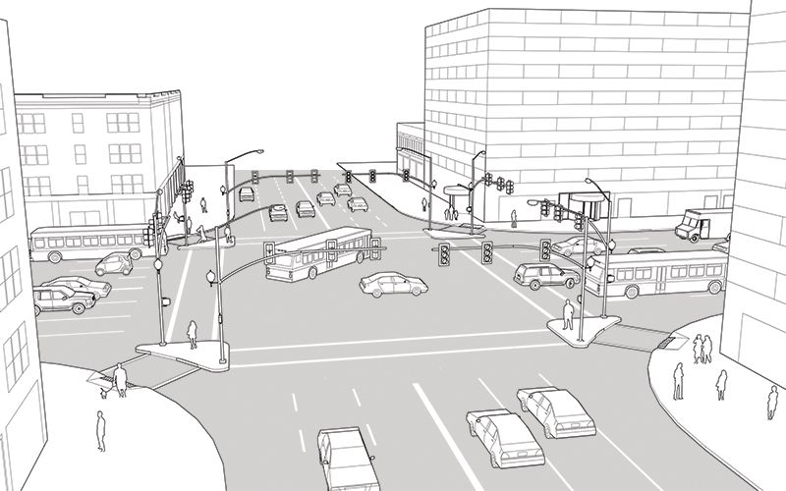
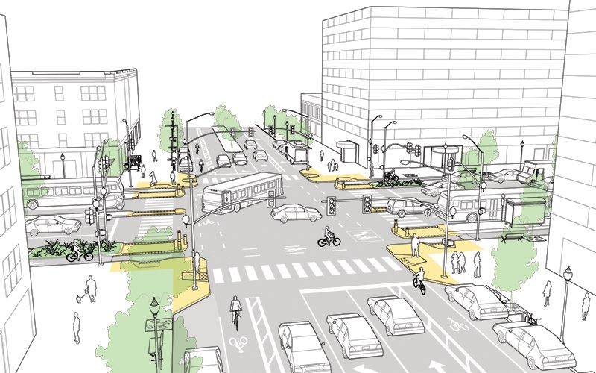
Identify the Pedestrian Safety Problems and Solutions
Higher Visual Friction and Street Trees
Before
After
Many Motor Vehicle Lanes
Low Visual Friction and No Street Trees
Motor Vehicle Lane Reduction
Transit and Bicycle Facility Improvements
Long Crossings
Crossing Islands
5
No Transit or Bicycle Facilities
5
1
1
3
6
3
2
6
4
Low-Visibility Crosswalks
2
4
2
Curb Extensions
High-Speed Turn Lanes Removed and Corner Radii Reduced
Contextually Inappropriate Target Speed (>25 mph)
Contextually Appropriate Target Speed (25 mph)
High-Speed Turn Lanes
High-Visibility Crosswalks
Graphic source: National Association of City Transportation Officials
Urban Street Design Guide – Major Intersections
Notes:
Talking Points:
Many pedestrian safety problems are common on typical urban arterial streets and pedestrian safety solutions exist for every existing problem.
Speaker asks participants: What pedestrian safety issues do you see in the before picture?
After a few participants have answered, click through the first SEVEN issue labels. Do not click more than seven times, or you will start to show answers to the next question.
Issues:
Multiple motor vehicle lanes
Wide corner radii with high-speed turn lanes
Long, unprotected Crossings
Low-visibility crosswalks
Design target speed >25 mph
No visual friction along corridor and no street trees – encourages higher motor vehicle speeds
No transit or bicycle facilities
Speaker ask participants: Are you already familiar with any of the pedestrian safety treatments in the after picture? Which ones? How many long, unprotected crossings are there? Why could a high-speed turn lane be dangerous for pedestrians? How could a lack of transit or bicycle facilities contribute to the existing pedestrian safety problems?
Solutions:
Lane reduction for motor vehicles (fewer motor vehicle travel lanes)
Reduced corner radii, high-speed turn lane removal, and curb extension addition
Crossing Islands (also called raised refuge islands or refuge islands)
High-visibility crosswalks
Design Target Speed = 25 mph
Street trees (create visual friction along the corridor, which can result in traffic calming/speed reduction effects)
Transit and bicycle facility improvements (complete the street and confer additional traffic calming benefits, encourage tighter motor vehicle lane geometry, and increase driver awareness of other modes, thereby also improving safety for pedestrians)
Speaker note: The crossing island in this after image appears to be relatively narrow and may need to be wider to provide a pedestrian refuge.
Image: http://www.pedbikeimages.org/details.php?picid=294
Graphics source: https://nacto.org/publication/urban-street-design-guide/intersections/major-intersections/

Slide 35
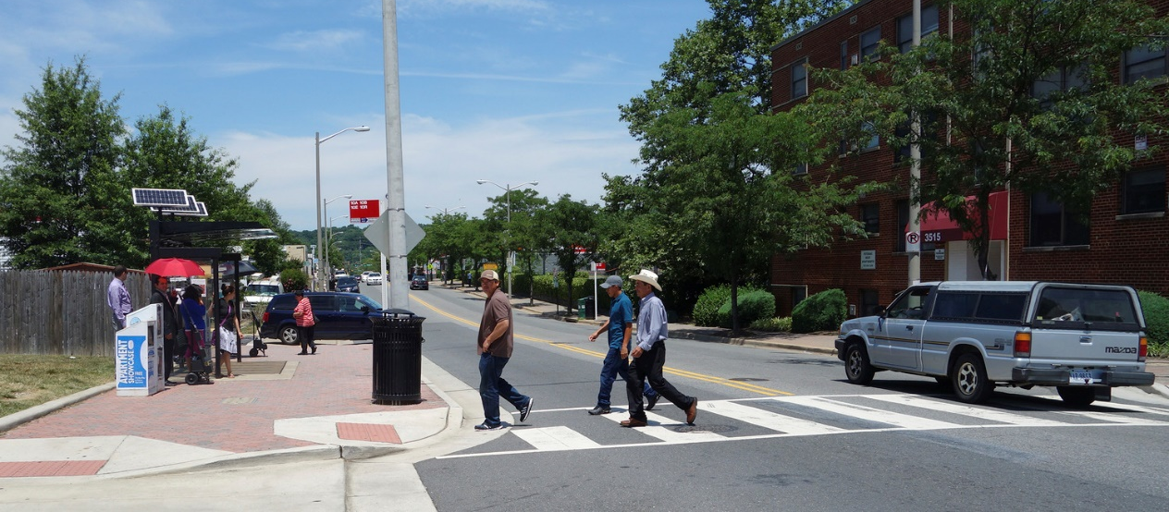
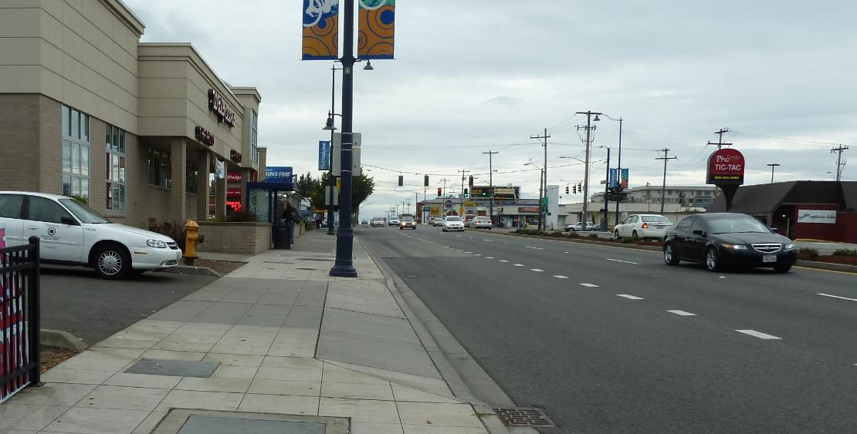
Planning and Design Considerations
Motor vehicle volumes, speeds, and turning movements
Roadway crossing width
Driveway and intersection frequencies
Transit considerations
Pedestrian generators and desire lines
Vulnerable populations
Pedestrian network characteristics and connectivity gaps
Photo source: Toole Design Group
Notes:
Talking Points:
There are many things to consider when evaluating pedestrian safety on arterials and assessing options for safety improvements.
Speaker note: Read some or all of the planning and design considerations on the slide and discuss with the audience.

Slide 36
Safety Treatment Application Considerations
Based on:
Existing and Future Land Use and Transportation Context
Project Roadway Type
Geometric/Physical Constraints
Policy and Financial Context
Identification of Priority Users
Rural
Rural Town
Suburban
Urban
Urban
Core
Graphic adapted from FDOT Context Classification Guide
Notes:
Talking Points:
As we discussed earlier, arterials exist in a broad range of land-use contexts and different safety treatments may be appropriate in different contexts.
The type of existing or future road function, nearby land use, existing development near the road, policy and financial considerations all play a role in selecting pedestrian safety treatments on arterial roads.
Many jurisdictions have also identified pedestrians as their highest priority road users to facilitate clear and consistent decisions about the importance of improving pedestrian safety through roadway engineering projects.

Slide 37
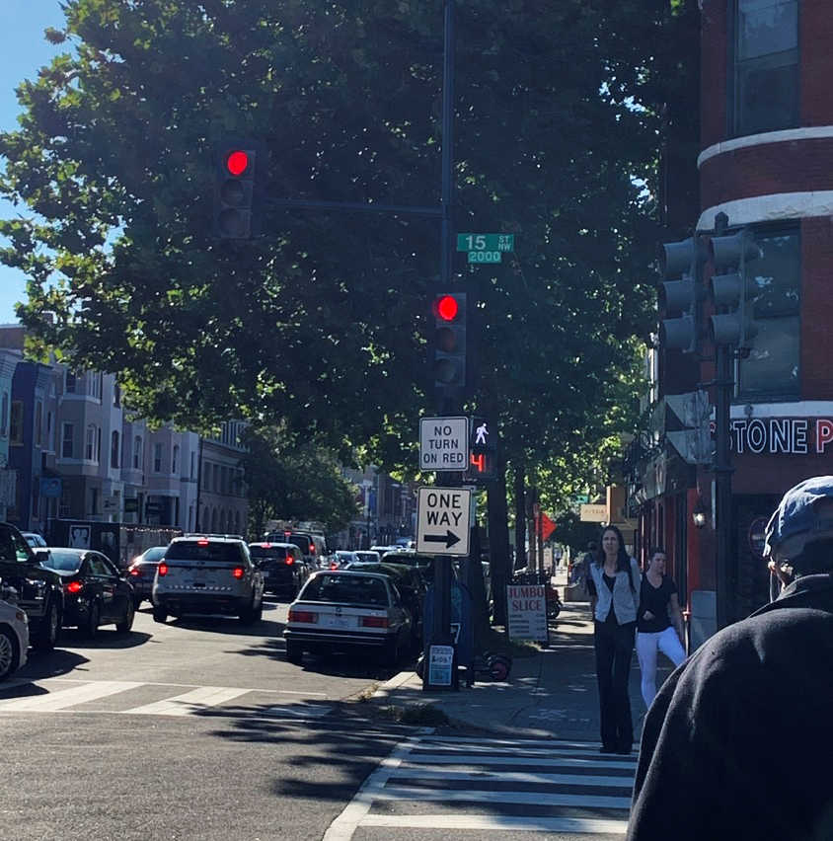
Which Treatments are Effective?
Research supports evidence of crash reduction by implementing roadway safety treatments
Crash reduction estimates do not exist for all treatments, but other research and prior use can indicate safety benefits
Multiple treatments at the same location often have complementary benefits
Photo source: Toole Design Group
37
February 7, 2023
Notes:
Talking Points:
Research has quantified the estimated reduction in pedestrian crashes, serious injuries, or deaths—as well as reductions in crashes, serious injuries, and deaths for other road users– that can result from the implementation of safety treatments.
Not all safety treatments widely in use today have established crash reduction estimates, although research is ongoing to establish crash reduction estimates for additional pedestrian safety treatments.
If multiple pedestrian safety treatments are implemented at the same location – for example, a curb extension, crossing island, high-visibility crosswalk, and leading pedestrian interval—the overall safety impact is greater.
Sources:
USDOT. 2008. Toolbox of Countermeasures and Their Potential Effectiveness for Roadway Departure Crashes. US Department of Transportation, Federal Highway Administration. FHWA-SA-07-013.
For more technical information on crash reduction estimates, see the Crash Modification Factors (CMF) clearinghouse at: http://www.cmfclearinghouse.org/userguide.cfm

Slide 38
Implementation Options
Low-Cost Rapid Treatments
Corridor (Re)construction
Network (Re)design
Cost | Low | Medium | High
Implementation Timeline | Fast | Medium | Slow
Implementation Effort | Low | Medium | High
Safety Benefits | Low to Moderate | Moderate to High | High
Livability Benefits | Low | Moderate | High
Notes:
Talking Points:
Let’s consider the different types of pedestrian safety treatment implementation that are available to transportation agencies.
Network Redesigns – A network redesign knits back together a disjointed road network. For example, it can reconnect cul-de-sacs to collector and arterial roads, which reduces pressure on arterials, distributes pedestrian and motor vehicle volumes, and allows for tamer arterial road conditions. Network redesigns require moving roads, purchasing significant rights-of-way, and may involve the demolition of existing structures with just compensation.
Corridor Reconstruction – These individual capital projects comprehensively redesign a single corridor. Corridor redesigns can fundamentally transform how a street looks, feels, and functions. Corridor redesigns that are attentive to pedestrian safety needs can result in dramatic safety improvements, since a corridor redesign allows for the implementation of multiple significant changes simultaneously and more substantial changes than may be possible with spot or rapid-implementation treatments. Similarly, the complete redesign of an intersection can fundamentally change its geometry, remove intersection approaches or slip lanes, thereby substantially improving pedestrian safety.
Low-Cost Rapid Treatments – Lower-cost and rapid-implementation safety treatments are interim solutions that can achieve short-term safety benefits or pilot-test corridor or intersection redesigns. These lower cost safety treatments are often implemented rapidly across an entire roadway network to improve pedestrian safety at multiple locations where high risk of a pedestrian fatality or serious injury exists. All projects, including low-cost rapid treatments, should be planned and designed to be fully accessible for people with disabilities.
Spot safety treatments are relatively quick to implement and can realize immediate safety improvements. However, for transformative impacts on pedestrian safety and to create compelling places where people want to live, work, and play, more comprehensive corridor and network pedestrian-safety and accessibility-oriented improvements are often needed.

Slide 39
Implementation Challenges
Arterials are complex environments
High traffic volumes
Multiple lanes
Commercial driveways
Bus routes and stops
Traffic signals and intersections
Corridor or network redesigns are required to meet agencies’ pedestrian safety goals
Transformative safety improvements are high-cost and have long-term implementation timelines
Notes:
Talking Points:
As we’ve discussed throughout this presentation:
Arterial streets are often complex environments.
The complexity of many arterials can make implementation of transformative safety improvements more challenging and costly.
Nonetheless, these significant redesign projects are often necessary to make the improvements needed to meet agencies’ safety goals.
While longer-term safety improvements are planned and programmed, interim and incremental safety improvements can be made through quick-build project implementation.
All projects, including quick-build alterations, should be planned and designed to be fully accessible for people with disabilities.

Slide 40
Implementation Solutions
Interim safety improvements through rapid-implementation projects
Quick and less costly
Designed to save lives
Often help refine capital projects based on real-world use
Coordination among safety, engineering, asset management, capital program, and other staff to deliver accessible, quality facilities
Systemic safety analysis – improvements throughout the road network at locations most likely to result in a fatality or serious injury
Agency leadership that prioritizes safety and accessibility
Notes:
Talking Points:
A variety of solutions are available to deliver pedestrian safety improvements on arterial roads.
Interim safety improvements can be achieved through rapid-implementation projects. Coordination among agency staff will help to deliver quality facilities and systemic safety analysis can help to identify improvements at locations most likely to result in a fatality or serious injury.
A critical ingredient to success is agency leadership that prioritizes safety and accessibility.

Slide 41
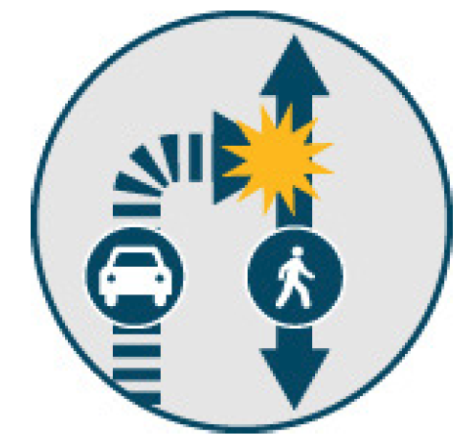
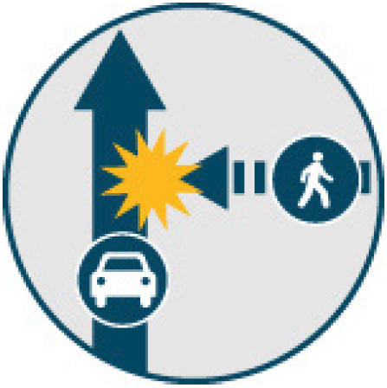
Common Pedestrian Crash Types
Left Turn
Right Turn
Going Straight
Graphics source: NCHRP Research Report 926 Guidance to Improve Pedestrian and Bicyclist Safety at Intersections, 2020
41
February 7, 2023
Notes:
Talking Points:
Now let’s talk in more detail about the crashes we’re trying to avoid.
Pedestrian crashes can be summarized using the movement of the striking vehicle (turning left, turning right, or going straight).
These different “types” of crashes can be addressed with different treatments.
Some treatments are applicable to more than one pedestrian crash type.
For example, a road diet may reduce both through vehicle speeds and crossing distances, thereby reducing the likelihood of all pedestrian crash types.
Source:
NCHRP Research Report 926 Guidance to Improve Pedestrian and Bicyclist Safety at Intersections.

Slide 42
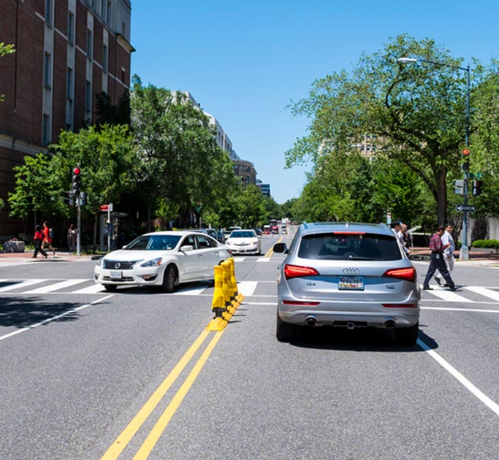
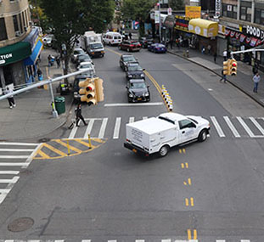
Examples of Left-Turn Pedestrian Safety Treatments
Photo source: Quartz
Photo source: IIHS
Left-Turn Wedge
Hardened Centerline
Notes:
Talking Points:
Potential treatments for left turn pedestrian crashes include hardened centerlines and turn wedges to calm left turns by channelizing and slowing left turning vehicles.
Source:
Right image: NYCDOT Pedestrian Safety Turn Calming Program https://www1.nyc.gov/html/dot/html/pedestrians/turn-calming.shtml

Slide 43
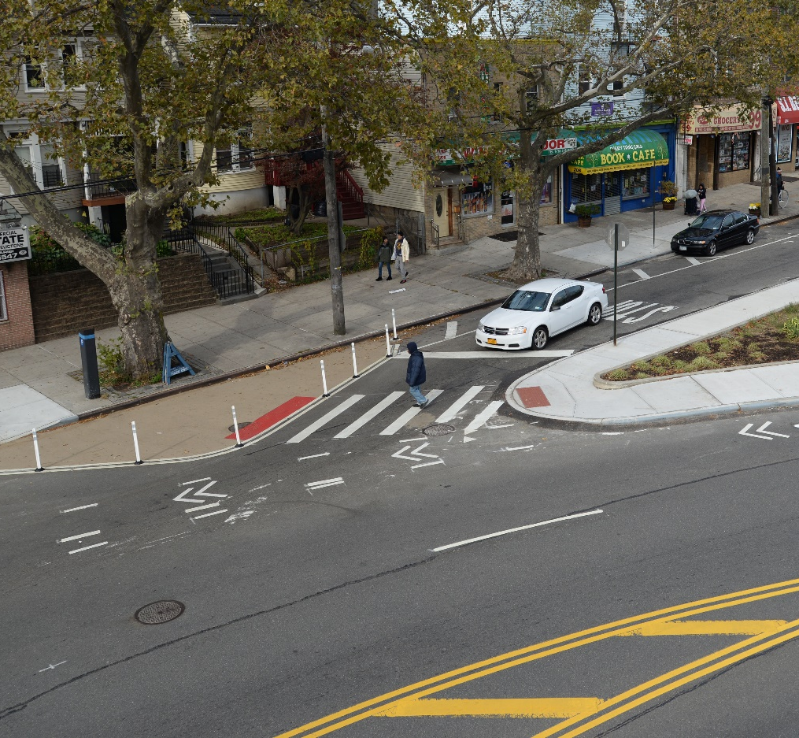
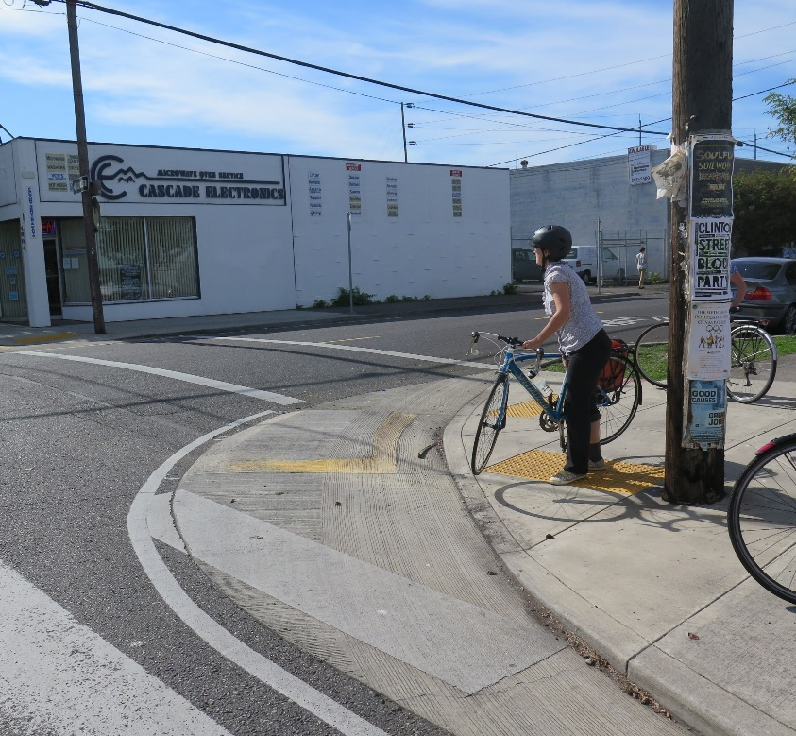
Examples of Right-Turn Pedestrian Safety Treatments
Photo source: Toole Design Group
Photo source: NYC DOT
Leading Pedestrian Interval
Corner Radius Reduction
Notes:
Talking Points:
Right-turning motorists striking pedestrians is also a common crash type. This is also often referred to as a “right hook.”
Examples of countermeasures for the right-turn crash type include the use of Leading Pedestrian Intervals (LPI’s) and corner radius reductions. Accessible Pedestrian Signals (APS) ensure that people with vision disabilities can also make use of the LPI.

Slide 44
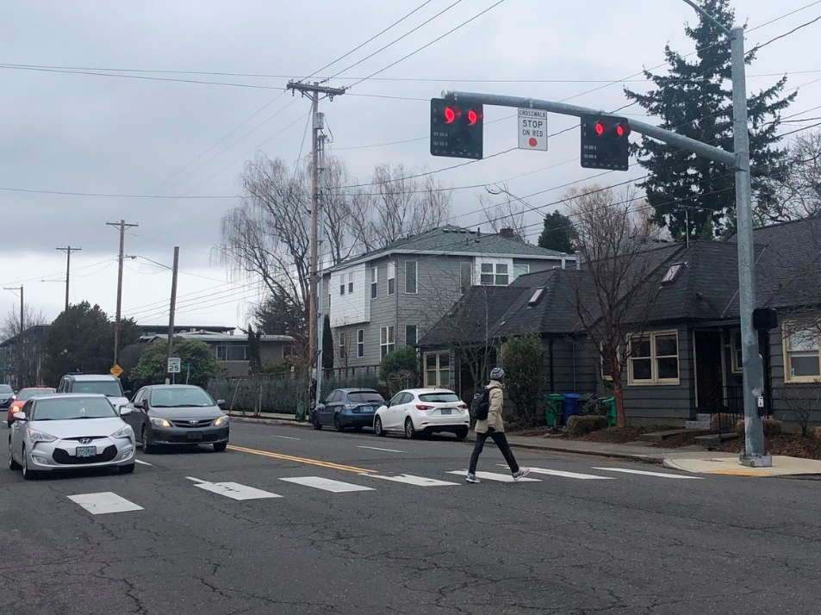
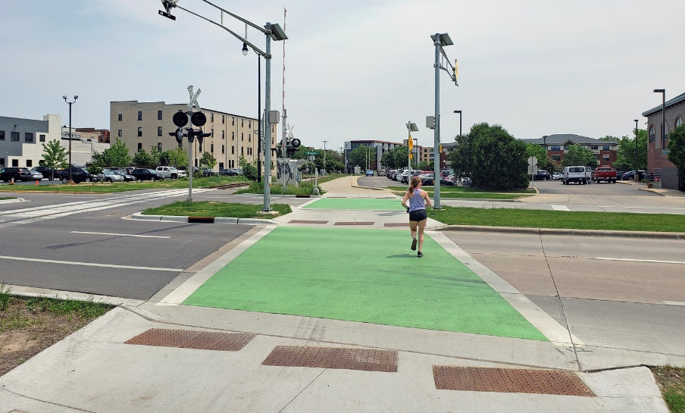
Going Straight Pedestrian Safety Treatments
Rectangular Rapid Flashing Beacon (RRFB)
Pedestrian Hybrid Beacon (PHB)
Photos source: Toole Design Group
Crossing Island
Notes:
Talking Points:
Numerous countermeasure options may be effective in reducing crashes between pedestrians and motor vehicles going straight.
Rectangular Rapid Flashing Beacons encourage drivers to yield to and stop for pedestrians at designated crossings of arterials.
Pedestrian Hybrid Beacons provide a stop phase with a solid red light for drivers to make pedestrian crossings of arterials safer.
Crossing islands reduce crossing distance and provide a refuge for pedestrians between opposite-directions of motor vehicle travel lanes.

Slide 45
Key Additional Pedestrian Safety Treatments
Pedestrian Pathways (e.g., Sidewalks and Shared-Use Paths)
Curb Extensions
High-Visibility Crosswalks
Lighting
Pedestrian Signals and Signal Timing (e.g., Protected Phases)
Pedestrian Hybrid Beacons (PHB)
Posted Speed Limit (e.g., School Speed Zones)
Roundabouts
Notes:
Talking Points:
There are many other treatments available to planners and engineers to improve pedestrian safety. Here are some of the most common and highly effective:
Pedestrian Pathways (e.g., Sidewalks and Shared Use Paths)
Curb Extensions
High-Visibility Crosswalks
Lighting
Pedestrian Signals and Signal Timing (e.g. Protected Phases)
Pedestrian Hybrid Beacons (PHB)
Posted Speed Limit (e.g., School Speed Zones)
Roundabouts

Slide 46
Safety Benefits of Common Safety Treatments
Treatment | Reduce Speeds | Safer Crossings | Increase Visibility | Reduce Conflicts | Mode Separation | Rural Road Safety
Chicanes / Roadway Curvature | • | •
Corner Radius Reduction | • | • | • | • | •
Crossing Islands | • | • | • | • | • | •
Curb Extensions / Bulb Outs | • | • | • | • | • | •
Gateway Treatments |  |  | • | •
Hardened Centerlines and Turn Wedges |  | • | • | • | •
High-Visibility Crosswalks |  |  | • | •
Leading Pedestrian Intervals |  |  | • | • | •
Lighting |  |  | • | •
Parking Restrictions at Crossing Locations / Daylighting |  | • | • | •
Pedestrian Hybrid Beacons (PHB) |  | • | • | • | • | •
Pedestrian Pathways (Sidewalks and Shared-Use Paths) |  |  | • | • | • | •
Pedestrian Signals and Signal Timing (e.g. Protected Phases) | • | • |  | • | •
Posted Speed Limit (Target Speeds and School Speed Zones) | • | • |  |  |  | •
Protected Crossing Spacing for Managing Conflicts | • | • | • | • | • | •
Protected Phases |  | • |  | • | • | •
Raised Crossings / Raised Intersections | • | • | • | •
Rectangular Rapid Flashing Beacons (RRFB) |  | • | • | •
Road Diets and Lane Width Reductions | • | • | • | • |  | •
Roundabouts | • | • | • | • | • | •
Table source: Adapted from the City of Philadelphia Pedestrian Safety Action Plan (May 2021)
46
February 7, 2023
Notes:
Talking Points:
This more comprehensive list of common pedestrian safety treatments shows the categories of benefits that each provides.
Some, such as crossing islands, protected crossing spacing for managing conflict, and roundabouts can improve pedestrian safety across all categories of benefits.
Others are more targeted to provide a particular category, or set of categories, of pedestrian safety benefits, such as posted speed limit reductions, which can result in reduced speeds, safer crossings, and enhanced rural road safety, but do not increase visibility, reduce the number of conflicts, or separate modes.

Slide 47
STEP Studio: Pedestrian Safety Treatment Selection and Application
Includes guidance on:
Data collection
Analysis
Countermeasure selection
Design and installation considerations
Implementation
Monitoring outcomes
Source: FHWA, 2020.
47
February 7, 2023
Notes:
Talking Points:
The Federal Highway Administration’s Safe Transportation for Every Pedestrian (STEP) Program has developed multiple resources to guide the selection and implementation of pedestrian safety treatments on arterial roads.
The STEP Studio resource is a new guidebook that includes detailed and approachable guidance on all steps in the safety treatment implementation process.
Source:
FHWA STEP Studio https://safety.fhwa.dot.gov/ped_bike/step/resources/

Slide 48
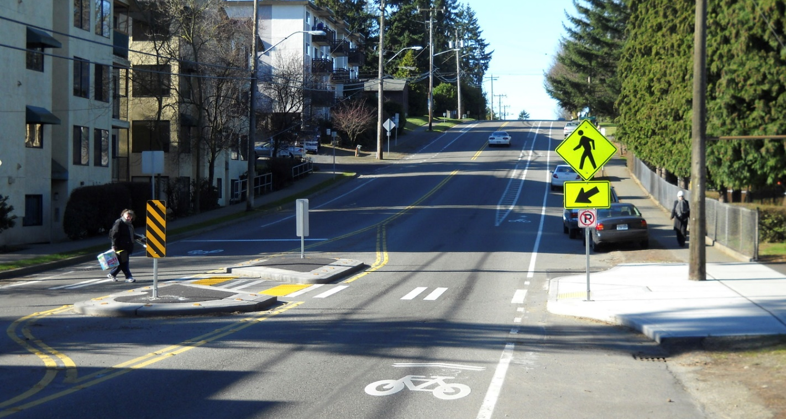
Featured Transformative Treatment: Road Diets
Road diets reduce the number or width of travel lanes
Create space for pedestrian facilities:
Crossing islands
Curb extensions
Sidewalks - with physical buffers
Multiple pedestrian safety benefits:
Shorter crossing distances
Speed management
Photo source: Toole Design Group
48
February 7, 2023
Notes:
Talking Points:
Road diets are a transformative treatment with multiple pedestrian safety benefits.
They shorten crossing distances and reduce motor vehicle through and turn speeds.
Implementing a road diet also frees up space in the right-of-way for critical pedestrian safety infrastructure, such as:
Crossing islands,
Curb extensions, and
Sidewalks with physical buffers between motor vehicle lanes and the sidewalk edge.

Slide 49
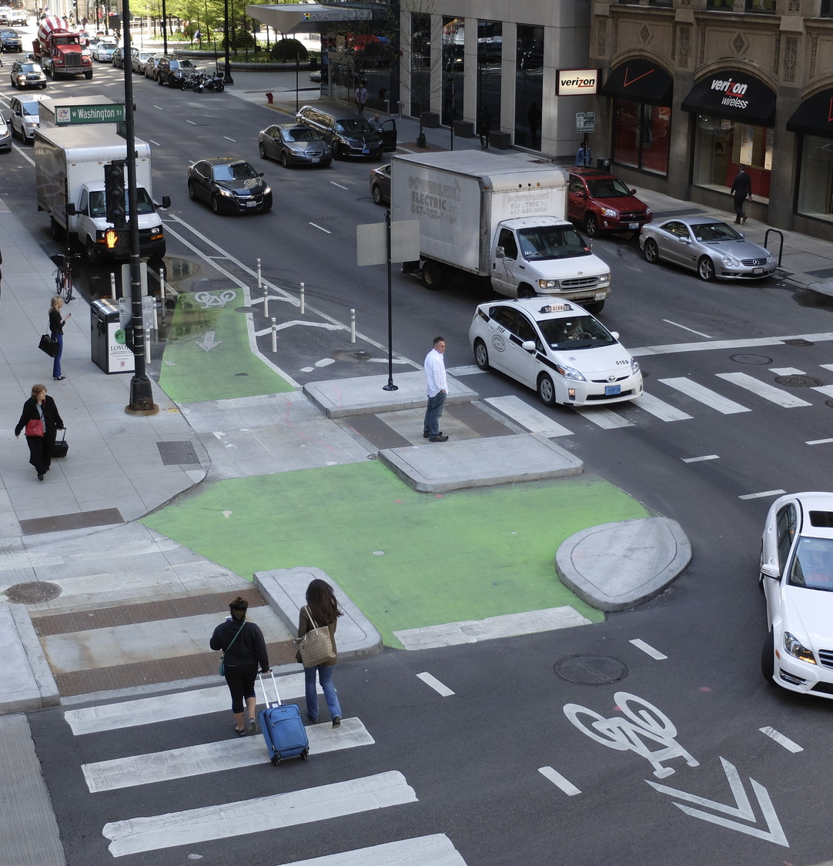
Case Study: Protected Intersections
Protected intersections use floating curb islands to improve safety for all road users
Multiple pedestrian safety benefits:
Slow through and turn speeds
Channelize turns
Shorten crossing distance
Can be used with crossing islands
Photo source: Toole Design Group
49
February 7, 2023
Notes:
Talking Points:
Protected intersections use floating curb islands to provide better physical separation between modes and enhanced channelization of motor vehicle through and turn movements.
This design provides multiple safety benefits for pedestrians and protected intersections are being implemented in jurisdictions throughout the United States.

Slide 50
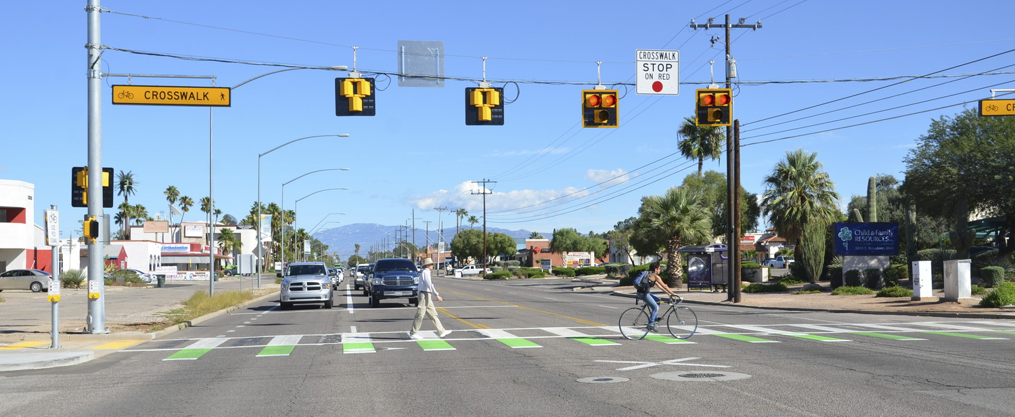
7. Resources
Photo source: Toole Design Group
Notes:
Talking Points:
The next section provides an overview of the many resources available to practitioners as they work in their communities to improve safety conditions on arterial roadways.
Speaker note: State law will inform the extent to which bicyclists in the bicycle crossing have legal protection like pedestrians. The League of American Bicyclists provides a summary of state laws pertaining to bicycle safety, which is available at https://bikeleague.org/StateBikeLaws

Slide 51
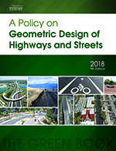
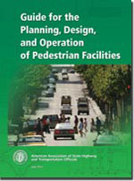
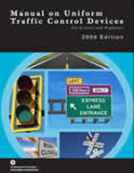
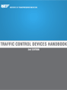
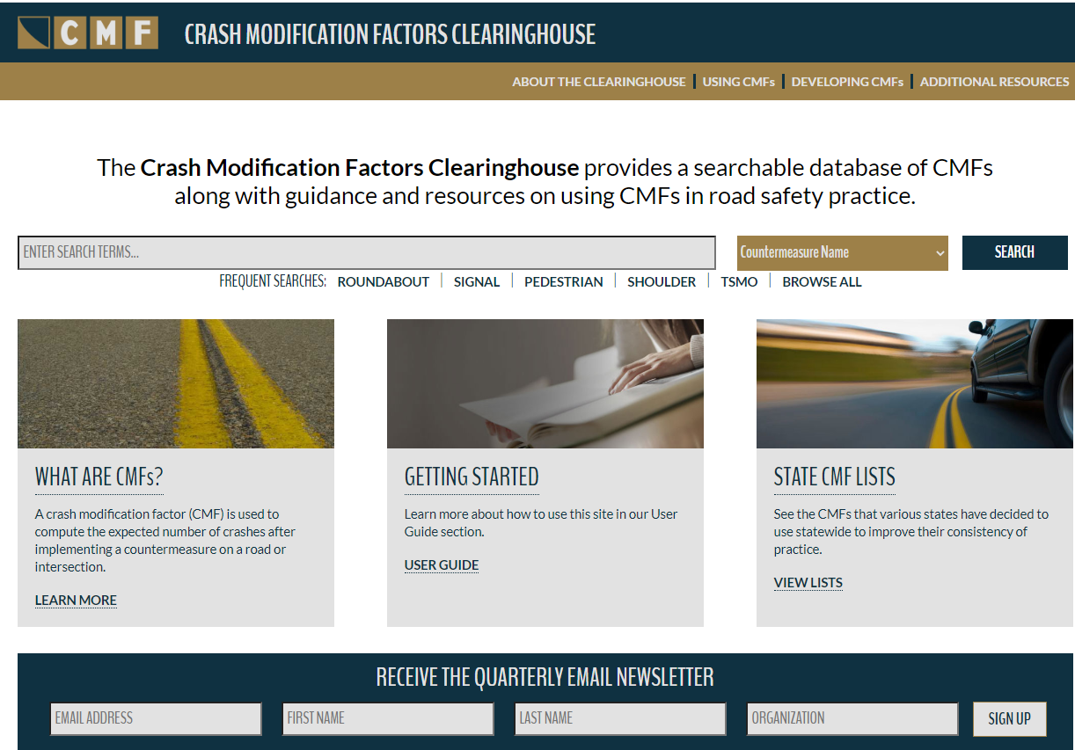
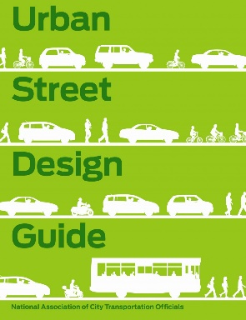
Resources
Notes:
Talking Points:
There are many resources that provide information on how to create safer conditions for people walking.
Note to speaker: List some or all of the sources below.
Sources:
PEDSAFE (FHWA)
FHWA Crash Modification Factors Clearinghouse
AASHTO A Policy on Geometric Design of Highways and Streets
AASHTO Guide for the Planning, Design, and Operation of Pedestrian Facilities
Manual on Uniform Traffic Control Devices (MUTCD)
ITE Traffic Control Devices Handbook
NACTO Urban Street Design Guide
Achieving Multimodal Networks: Applying Design Flexibility and Reducing Conflicts
ITE Implementing Context Sensitive Design on Multimodal Thoroughfares: A Practitioner’s Handbook
ITE Design Guidelines for the Accommodation of Pedestrians and Bicyclists at Interchanges
FHWA Guide for Improving Pedestrian Safety at Uncontrolled Crossing Locations
FHWA Toolbox of Countermeasures and their Potential Effectiveness for Pedestrian Crashes
NCHRP Research Report 926: Guidance to Improve Pedestrian and Bicyclist Safety at Intersections

Slide 52
Key Resources
USDOT Equity Information and Resources
FHWA Zero Deaths and Safe Systems Resources
FHWA Office of Safety: Pedestrian and Bicycle Safety
FHWA Safe Transportation for Every Pedestrian (STEP)
NCHRP Research Report 926: Guidance to Improve Pedestrian and Bicyclist Safety at Intersections
FHWA Toolbox of Pedestrian Safety Countermeasures and Their Potential Effectiveness
FHWA Complete Streets
Photo source: Toole Design Group
Notes:
Talking Points:
The following resources are also useful when addressing pedestrian safety challenges along arterial roads. These include:
USDOT resources and information on equity
FHWA policies and resources on Zero Deaths and Safe Systems
FHWA’s Safe Transportation for Every Pedestrian (STEP) guidance
Guidance from the National Academies to improve pedestrian safety at intersections (NCHRP Research Report 926), and
The FHWA Toolbox of Pedestrian Safety Countermeasures and their Effectiveness
Sources:
USDOT Equity Information and Resources
FHWA Zero Deaths and Safe Systems Resources
FHWA Office of Safety: Pedestrian and Bicycle Safety
FHWA Safe Transportation for Every Pedestrian (STEP)
NCHRP Research Report 926: Guidance to Improve Pedestrian and Bicyclist Safety at Intersections
FHWA Toolbox of Pedestrian Safety Countermeasures and Their Potential Effectiveness

Slide 53
8. Conclusion
Photo source: Toole Design Group
Notes:
Talking Points:
Let’s conclude with a note from FHWA on pedestrian safety implementation and review some key takeaways from today’s presentation.

Slide 54
Conclusion
“It is no longer acceptable to plan, design, or build roadways that do not fully accommodate use by bicyclists and pedestrians... With every passing year, the courts become less and less sympathetic to agencies that have not understood the message: bicyclists and pedestrians are intended users of the roadway.”
www.fhwa.dot.gov/publications/research/safety/pedbike/05085/pdf/lesson22lo.pdf
Notes:
Talking Points:
As noted in this quote from FHWA’s University Course on Bicycle and Pedestrian Transportation, “It is no longer acceptable to plan, design, or build roadways that do not fully accommodate use by bicyclists and pedestrians... With every passing year, the courts become less and less sympathetic to agencies that have not understood the message: bicyclists and pedestrians are intended users of the roadway.”

Slide 55
Conclusion
Arterial roadways are uniquely challenging from a pedestrian safety standpoint, because of:
Motor vehicle volume
Motor vehicle speed
Land use characteristics
Tools and resources are available to improve pedestrian safety
Now is the time the deploy these measures in a systemic way, to reduce and eventually eliminate pedestrian fatalities and serious injuries
Photo source: Toole Design Group
Notes:
Talking Points:
As we have demonstrated today, ensuring pedestrian safety on arterial streets is a complex undertaking, but there are resources available to planners and engineers to address this issue.
FHWA has provided these resources for communities to systemically evaluate the locations with greatest pedestrian safety risk and redesign arterial roads to improve pedestrian safety.
Important activities include conducting regular systemic pedestrian safety analyses, identifying appropriate countermeasures, and prioritizing and implementing life-saving safety measures.
Now is the time to deploy these measures in a systemic way, to reduce and eventually eliminate pedestrian fatalities and serious injuries in our transportation network.

Slide 56
Contact Information
Name
E-Mail
Title
Organization
Website
Photo source: Toole Design Group
56
February 7, 2023
Notes:
Talking Points:
Thank you very much for your time and attention today. For more information, please feel free to contact us or visit our agency’s website for more information.

